Slide 1
REACH CODE IMPLEMENTATION RESOURCES TEMPLATE
This template is intended for educational purposes only, without any express or implied warranty of any kind, including warranties of accuracy, completeness, or fitness for any particular purpose. You agree that your use of the template is without any recourse whatsoever to PG&E, SCE, SDG&E, SCG, or their affiliates. The template is a draft, and anyone using this document should seek the advice of an attorney to develop appropriate ordinance language to meet its jurisdiction’s specific needs, as state and local laws may differ.
This document is the product of a collaborative effort:
BayREN
Building Decarbonization Coalition
East Bay Community Energy
Peninsula Clean Energy
Silicon Valley Clean Energy
Statewide Utility Codes and Standards Program: Reach Codes
& Staff from Multiple California Jurisdictions
For additional information contact info@LocalEnergyCodes.com
Notes:
Focused on All-electric and note all electric with EE or additional PV- basing this on checklists.

Slide 2
Reach Code Training – [AHJ]
Presenter Name:
Date:
Notes:
Description: Heat pump water heaters (HPWHs) are an increasingly popular technology that are a highly efficient means of providing hot water in residential and commercial buildings. This training will describe HPWHs, when HPWHs are allowed under 2019 Codes, code requirements for installation, and how to complete compliance forms.
Topics Covered: Reach code specific to jurisdiction
Target Audience: Permit technicians, plan checkers, and field inspectors.
Duration: Short Course (60 min)

Slide 3
Zoom Meeting How To’s
Please mute yourself- use chat function if you have a question or comment.
We will break for questions periodically.

Slide 4
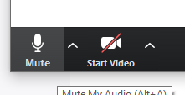

Zoom Meeting How To’s
Mute button in lower left-hand corner
Chat button in middle of tool bar

Slide 5
Zoom Meeting How To’s
Functionality we will be using:
  Group exercise where we encourage you to turn your video on and work collaboratively!
  Open Q&A at the end

Slide 6

Introduction

Slide 7
Agenda
Introduction on Why Reach Codes
Building Reach Code: Overview and compliance
Plan Review Exercise
Electric Vehicle Reach Code: Overview and compliance
Plan Review Exercise
Questions and Answers

Slide 8
Learning Objectives
Understand energy code AND reach code requirements for new and existing construction (Single Family, Multifamily and Nonresidential)
Understand the overall compliance process including how compliance forms are used.
Focus plan review and field verification efforts on most impactful building energy features.

Slide 9
Handouts
Handouts are available here:
  Checklist Summary New Construction for [AHJ]
  New Construction Checklists
  Existing Buildings (Additions and Alterations) Checklists
  [Ordinance Name] adopted by [AHJ]
Notes:
Help instructor to give context for the module; setting time expectations per section
Allow time for discussion and questions

Slide 10
Background

Slide 11
What Are Reach Codes &
Why Are Cities Passing Them?

Slide 12
Shifting Code Landscape - 2019 to 2022 to 2025
Including a CO₂ emissions metric (i.e. GHG emissions reduction) rather than straight energy savings
Supporting demand responsive and grid management
SB 100(2018)
Gov Exec Order (2018)
AB 3232 (2019)
SB 1477 (2019) and State Budget 2023
CARB (2022)
60% renewable /2030
100% carbon free/2045
Carbon neutrality by 2045 + 2022 bills to support
40% GHG reduction in buildings- assessment
$200M for low emission buildings and equipment + millions for decarbonization
35% of cars sold in CA are EV in 2026 and 100% by 2035

Slide 13
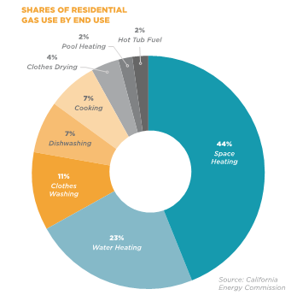
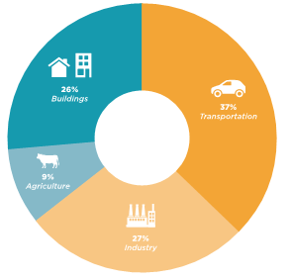
What is Building Electrification?
67% from space and water heating
Building Electrification means shifting from polluting fossil fuels to electricity for heating & cooking.
Electricity is on a path to zero-carbon by 2045 or sooner.
As the electricity supply gets cleaner, so do all-electric buildings.
Lowest-cost path to decarbonize buildings
Health, safety, & resiliency benefits.
Notes:
[FIRST]: 10% of total US GHG emissions are from burning methane gas (marketed as “natural” gas), propane, or oil for space heating, water heating, and/or cooking in buildings. (2020)
[bullets on slide]
[END]: Study after study shows that electrification is lowest-cost path to zero-carbon buildings compared to switching to green hydrogen or other renewable combustible fuels, while also bringing significant

Slide 14
CA’s Energy Code Pathway to Carbon Neutrality
Commercial ZNE
2045
Residential ZNE
2042
2038
2034
2031
Carbon Neutrality
100% carbon free (SB100)
2028
2025
2022
2019
60% Clean Energy (SB100)
40% reduction in GHG (SB32)
2016
2013
PV Req’d Low Rise
Storage credit
Heat pumps, PV and Battery in Baseline
PV Credit
New software
PV: Photovoltaic
ZNE: Zero net Energy

Slide 15
What is a Reach Code that drives to GHG reductions?
  Minimum Base Code
  Sets minimum levels of efficiency for building design and construction
  Reach Code
  Overlays the base code
  Includes additional requirements, such as:
    Energy efficiency
    Water efficiency
    Electrification
    Electric Vehicle (EV) charging infrastructure

Slide 16
What is Already Included in Title 24?

Slide 17
What’s already included in the Title 24 Update?
 | 2019 | 2022
 |  | 2-30% more efficient
Building Electrification | Electrification-ready water heating for low-rise residential Electric Code Baseline | Partial Electric Prescriptive Baseline Electrification-ready for all non- electric appliances in residential
Electric Vehicle Charging Infrastructure | EV parking requirements | More extensive EV parking requirements
Solar PV | + Required PV for low-rise residential | + Required PV for all occupancies + Battery in baseline for some occupancies

Slide 18
[AHL] Reach Codes

Slide 19
[AHJ] Reach Codes
Reach Codes
  [list ordinance name and number]
  [list ordinance name and number]
Amends [Part 11, Green Building Code; Part 6, Energy Code]
Adopted by Council on [date adopted]
The Ordinances were subsequently approved by the CEC on [enter date].
Notes:
as well as the PowerPoint presentation to City Council for proposed reach codes . All of the proposed reach codes represented in the PowerPoint presentation were adopted by Council on Dec. 3rd, 2019.The Energy Code proposed reach codes were subsequently approved by the CEC on February 20, 2020.

Slide 20
Summary of [AHJ] Reach Codes [update Table]
Occupancy Type | Building Electrification Reach Code | EV Charging Reach Code
Single Family (1-2 dwelling units) , townhomes, free standing ADUs - New Construction | All-Electric | Yes
Single Family Additions and Alterations | Yes addresses all-Electric appliances, readiness, and panel upgrades | Yes (based on scope of work)
Multifamily Projects – New Construction | All-Electric | Yes
Multifamily Projects – Additions and Alterations | Yes addresses all-Electric appliances, readiness, and panel upgrades | Yes (based on scope of work)
Non Residential – (All Occupancies) - New Construction | All-Electric | Yes
Non Residential (All occupancies)- Additions and Alterations | Yes addresses all-Electric appliances, readiness, and panel upgrades | Yes (based on scope of work)

Slide 21
Building Reach Codes

Slide 22
Definitions

Slide 23
Definitions
California Building Code Defines:
California Energy Code Defines:
California Green Building Code Defines:
Newly Constructed (or New Construction). A newly constructed building (or new construction) does not include additions, alterations or repairs
Does your definition of New Construction include Substantial Improvement or align with above?
Newly Constructed. A building that has never before been used or occupied for any purpose.
Newly Constructed Building is a building that has never been used or occupied for any purpose
Notes:
Conversions are not new construction.

Slide 24
Substantial Remodel/ Alteration
[Select Appropriate definition and delete others]
is any repair, reconstruction, rehabilitation, alteration, addition, or other improvement of a building structure, the cost of which equals or exceeds 50 percent of the market value of the structure before the improvement or repair is started. If the structure has sustained substantial damage, any repairs are considered substantial improvement regardless of the actual repair work performed.³
is any alteration(s) made within any three-year period that includes replacement of over 50 percent of the existing foundation for purposes other than a repair or reinforcement as defined in California Existing Building Code Section 202; or where over 50 percent of the existing framing above the sill plate is removed or replaced for purposes other than repair.
is any project that requires an electrical permit, a mechanical permit and a plumbing permit, with the exception of projects with a total valuation of less than $XX,XXX

Slide 25
Key Terms
All-Electric - Buildings using permanent supply of electricity for space heating, water heating, cooking, and clothes drying, with no natural gas or propane plumbing installed in building.
Energy Design Rating (EDR) – Total EDR A whole-house efficiency TDV metric that includes all end uses. Reference house meets IECC-2006 prescriptive standards with TDV. Emissions EDR is source energy and does not include TDV multiplier
Mixed-Fuel – Uses natural gas or propane as fuel for space heating, water heating, cooking appliances and/or clothes drying appliances or is plumb.
Compliance Margin – how much more energy efficient than code minimum can be done in a cost-effective manner, typically expressed as a percentage (e.g., 5% compliance margin)
Notes:
ALL-ELECTRIC BUILDING or ALL-ELECTRIC DESIGN is a building or building design that uses a permanent supply of electricity as the source of energy for all space heating, water heating (including pools and spas), cooking appliances, and clothes drying appliances, and has no natural gas or propane plumbing installed in the building.
CERTIFIED ENERGY ANALYST is a person registered as a Certified Energy Analyst with the California Association of Building Energy Consultants as of the date of submission of a Certificate of Compliance as required under Section 10-103.
MIXED-FUEL BUILDING or MIXED-FUEL DESIGN is a building or building design that uses natural gas or propane as fuel for space heating, water heating (including pools and spas), cooking appliances or clothes drying appliances or is plumbed for such equipment.

Slide 26
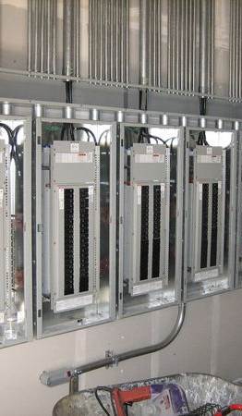
Key Terms – Electric-Ready
Electric-Ready with Pre Wire -
  Conductors are run from panel to junction box to support electric appliances in future.
Electric-Ready or Electric Capable with Conduit and Capacity
  Gas appliances in mixed-fuel building have designated conduit and raceways and reserved capacity on the main electrical panel and subpanels to support electric appliances in future.

Slide 27
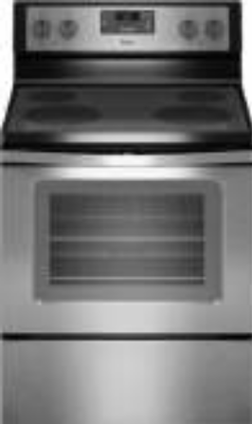
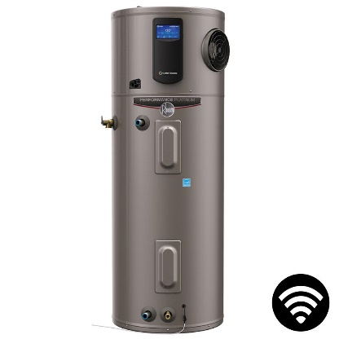
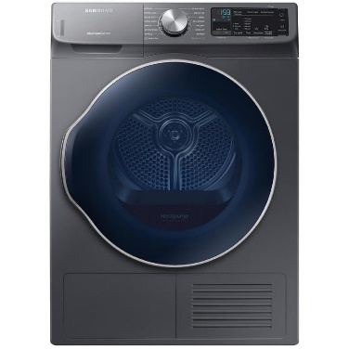
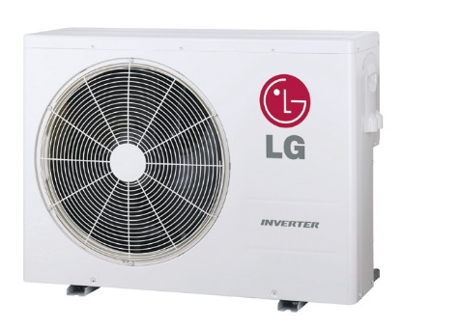
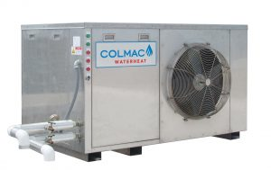
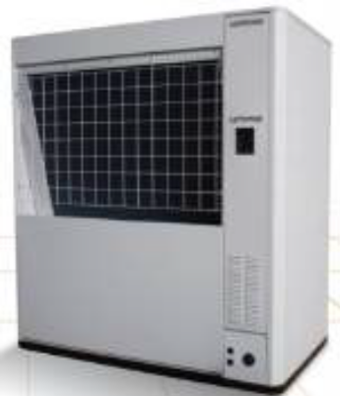
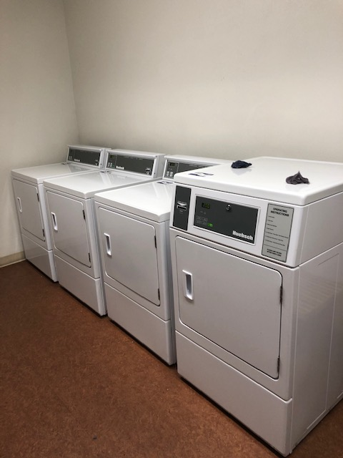
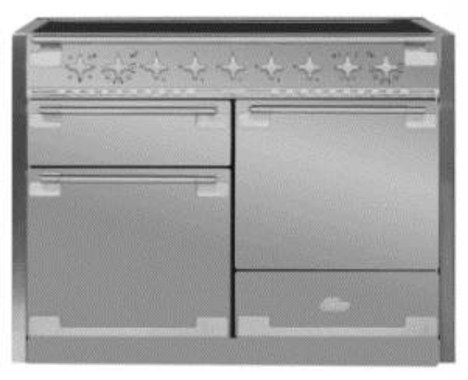
All-Electric Building Measures
Space Heating
Water Heating
Cooking
Clothes Drying
Residential
Commercial/ Large Residential

Slide 28
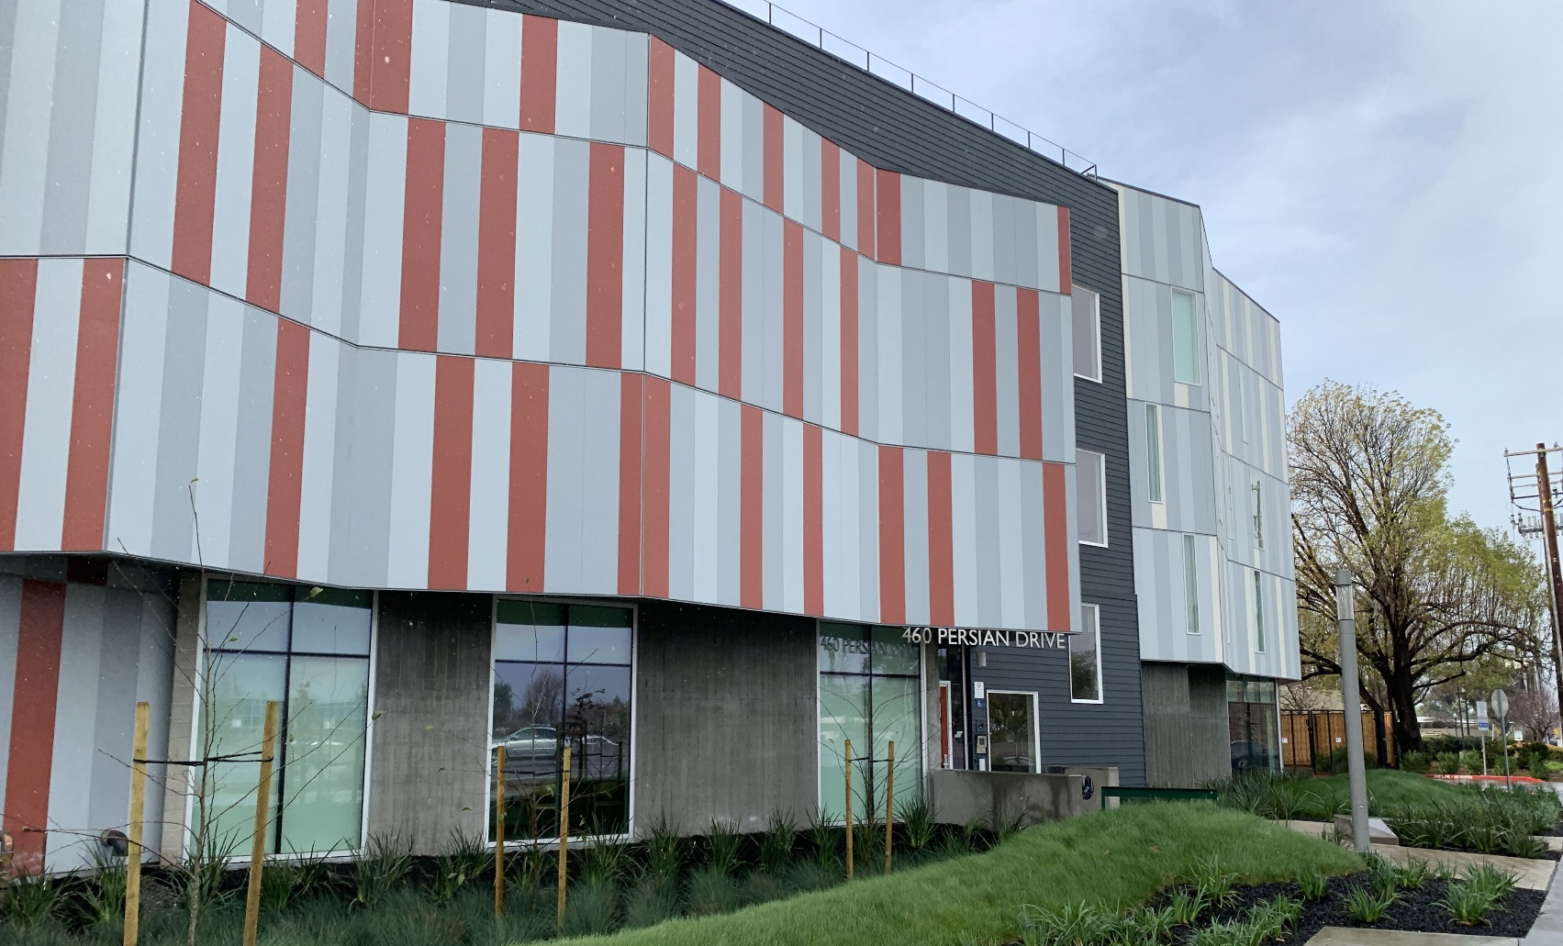
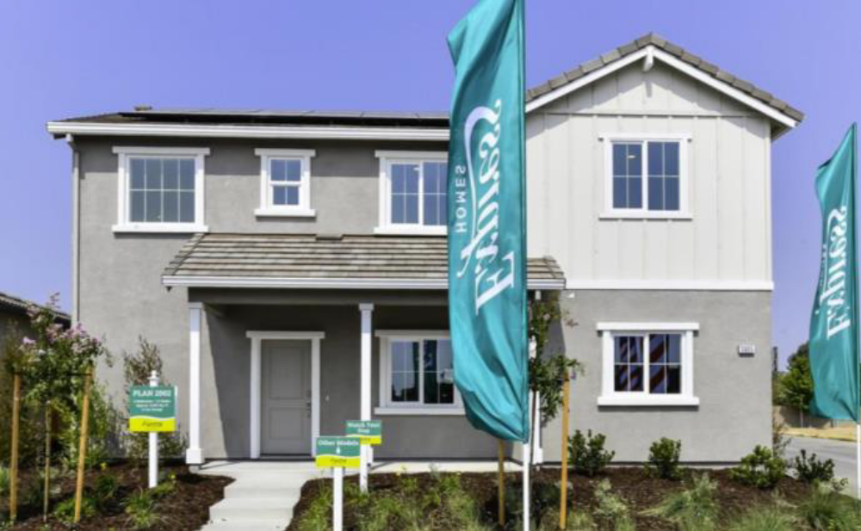
Examples
System | Multifamily | Single Family
HVAC | Individual unit ductless minisplits | Split heat pump system
DHW | Central Sanden CO2 Plant | Heat Pump Water Heater
Cooking | Electric resistance | Induction
Envelope | R21/ CMU +R8 (above T24) | 2016 Title 24 code (cavity and exterior insulation)
Credit: Midpen Housing, Benner Plaza and Juniper Development, DR.Horton

Slide 29
Energy Code Overview

Slide 30


Energy Code Compliance Options
Mandatory Measures: Minimum requirements that must always be met
Prescriptive Path
Usually a “prescribed” list of measures by CZ
No design flexibility
Common for alterations, changeouts, and smaller additions.
Performance Path
  The energy performance of the “prescriptive package” is the baseline, but tradeoffs are allowed.
  Based on an energy simulation using State-approved software (CBECC, EnergyPro, etc.)
  Very common for new construction and larger additions.
  Rare for alterations, changeouts, etc.
Pick One
+ REACH CODE
Notes:
Example of last point in “Performance Path”: Builders could install a HPWH with a higher UEF, while putting less insulation in the walls. As long as the savings from the more efficient HPWH as larger than the losses from the less efficient insulation, the building will earn compliance
Per CEC recommendations: mention other approved software exist (more options than CBECC and Energy Pro).

Slide 31
Performance Metric - Energy Design Ratings (EDR)
Single Family
EDR1
EDR2 (TDV)
Energy Source Design Rating
(New proxy for carbon)
+
Energy Efficiency Design Rating
Solar Electric Generation and Demand Flexibility Design Rating
Source EDR
includes energy
used by:
Envelope
IAQ
HVAC
DHW
Unregulated loads
TDV Efficiency EDR includes energy
used by:
Envelope
IAQ
HVAC
DHW
Unregulated loads
TDV Total EDR
includes energy
used by:
Efficiency EDR measures plus
Solar PV
Battery Storage
Precooling

Slide 32
Performance Metrics
Multifamily and Non-Residential
Source Energy (hourly emissions metric) includes energy used by:
Space Heating and Cooling
Ventilation
Water Heating
Indoor Lighting
Solar PV
Battery Storage
Covered Process Loads
TDV Energy (hourly energy cost metric) includes energy used by:
Space Heating and Cooling
Ventilation
Water Heating
Indoor Lighting
Solar PV
Battery Storage
Covered Process Loads
Section 170.1(b) The Proposed Building shall separately comply with the source energy budget and the TDV energy budget.

Slide 33
General Process: What is…
Required?
CF1FR/LMCC/ NRCC-PRF-01 Performance or Prescriptive Compliance
Installed?
CF2R/LMCI/NRCA/NRCCs and Installer Verified documents
Submit permit applications, plans and required documents
Verified?
CF3R/LMCA/ NRCVs for HERS verified measures
Rough and Final Inspections
Plan Review
Notes:
Are you all familiar with these forms and have looked at them during plan review and/or inspections for final CO?

Slide 34
Forms
Compliance
CF1R – Single Family (not MF residential)
Installation
CF2R- Single family (not MF residential)
LMCC- Low rise multifamily
NRCC – High rise multifamily and non residential
LMCI -Low rise multifamily
NRCA/NRCCs -High rise multifamily and non residential
Verification
CF3R- Single family (not MF residential)
LMCA- Low rise multifamily
NRCVs - High rise multifamily and nonresidential

Slide 35
Buildings – All Electric New Construction
Reach Code Overview

Slide 36
All-Electric: Newly constructed buildings are to be powered solely by electricity.

Slide 37
Reach Code Requirements
–
Single Family, Multifamily, Non-Residential
(ordinance no. XXX)
Building Type | Performance Path
All-Electric | Proposed/ Built home meets energy code and is all-electric No gas infrastructure installed in building
Mixed-Fuel | Not Allowed - Only Approved for exceptions. Requires pre wire or electric ready
CEC has defined an ADU as the following:
Detached ADU is new construction.
ADU with shared wall or conversion is addition.
Notes:
The metric should be updated for the specific metric for the reach code. On this slide is Total EDR Margin Other metrics include Total EDR or EE EDR Margin. The potential threshold are listed below.
Proposed/ Built project shall have a Total EDR Margin of [6,8,9,10] OR Total EDR [5,8,10,11,12,13,15,22,23] or EE EDR Margin of [ 0,1,2,3,4,5] for single family
Proposed/ Built project shall have a Total EDR Margin of [6,8,9,10] OR Total EDR [5,8,10,11,12,13,15,22,23]

Slide 38
Exceptions [edit and delete exceptions]
Not Feasible
Determined on a case-by-case basis. Burden on applicant to demonstrate.
Outdoor Appliance
Outdoor fireplaces or Barbeques are allowed to be supplied with propane or natural gas. Limits gas in building.
Specific Appliance
Specific appliance exemption granted but requires prewire for future electric appliance

Slide 39
Exceptions [edit and delete exceptions]
Life Science Buildings
Life science buildings may have non-electric appliances. Pre-wiring is not required.
Entitled Projects
Projects that received land use permit prior to ordinance affective date.
Commercial Food Processing
Minimally necessary and specifically tailored Fuel Gas Infrastructure shall be allowed on a revocable basis until the excepted uses no longer exist in the building

Slide 40
All Exceptions must [edit and delete exceptions]
Prewire
Install sufficient reserved circuit breakers and electrical conduit to facilitate future full building electrification as certified by affidavit of either a Registered Design Professional or a Licensed Electrical Contractor

Slide 41
Compliance

Slide 42
Checklist Submission vs. Department Verification
Applicant Checklist Submission
  Attesting to reach code compliance
Plan Review
  Verifying specific element and CF1R/ NRCC-PRF-01
Field Inspection
  Verifying specific elements
  CF2R/NRCA/NRCCs and CF3R/NRCVs and HERS registry: Building dept access and Project Status Report
Notes:
mention special building department access, Project Status Report (PSR), and "all green dots". (Field Inspection notes)

Slide 43
Compliance Process
Applicant
SUBMIT PLANS AND FORM DEMONSTRATING COMPLIANCE
Plan Check
VERIFY SPECIFIC ELEMENTS
Field Inspection
VERIFY SPECIFIC ELEMENTS
FINAL TITLE 24 DOCUMENTATION & CF2R/LMCI/NRCA/NRCCs and CF3R/LMCA/NRCVs -HERS DOCUMENTATION (Online HERS Registry)
CF1R/LMCC- PRF-01/NRCC-PRF-01
CF1R/LMCC- PRF-01/NRCC-PRF-01
Notes:
mention that the energy code docs exist in electronic format are readily accessible on line via HERS registry.

Slide 44
All Electric Plan Review

Slide 45

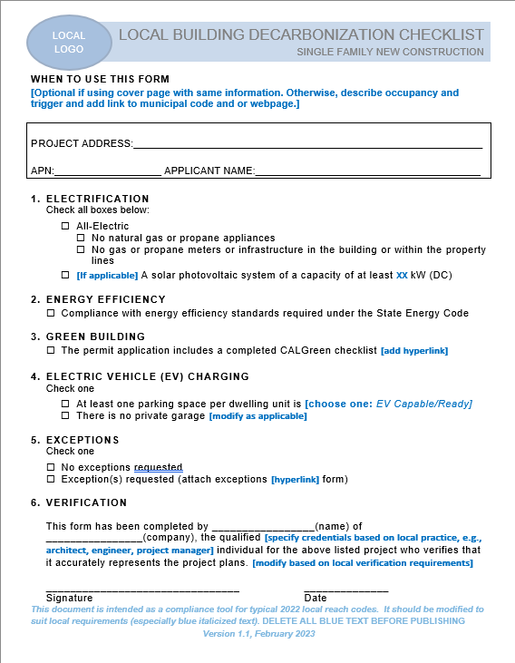
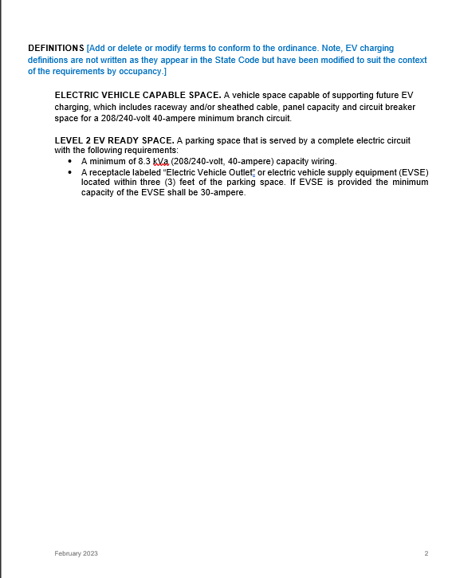
Form for Reach Code Compliance on the Plans
Notes:
Low Rise Residential Checklist: https://localenergycodes.com/download/1456/file_path/fieldList/2019%20Low-rise%20Residential%20Checklist.docx
High Rise Residential Checklist: https://localenergycodes.com/download/1457/file_path/fieldList/2019%20High-Rise%20Residential%20Checklist.docx
Nonresidential Checklist: https://localenergycodes.com/download/1458/file_path/fieldList/2019%20Nonresidential%20Checklist.docx

Slide 46

Plan Review – Performance Approach
Performance Threshold
Verification using Compliance documents and form for reach code compliance
All-Electric- Proposed Design < Standard Design and fuel is Electric
Form for ordinance compliance completed by applicant
Certificate of Compliance – CF1R/LMCC/ NRCC-PRF-01
Notes:
If the reach code uses Total EDR or EE EDR then the metric in performance threshold should be updated

Slide 47
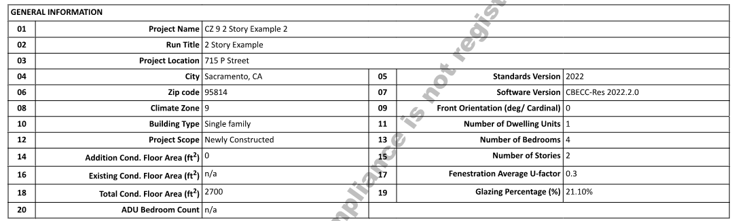
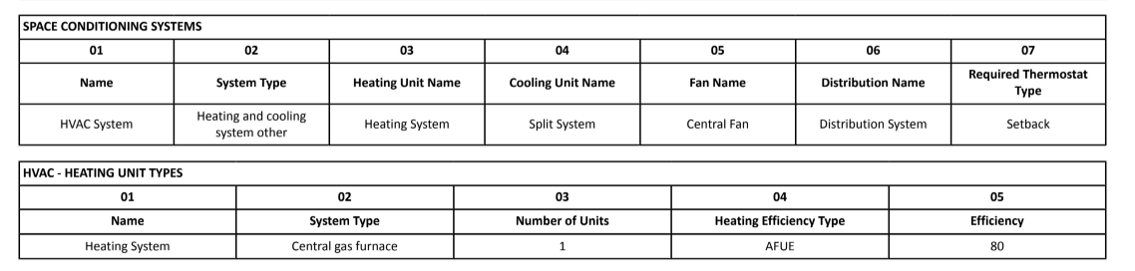
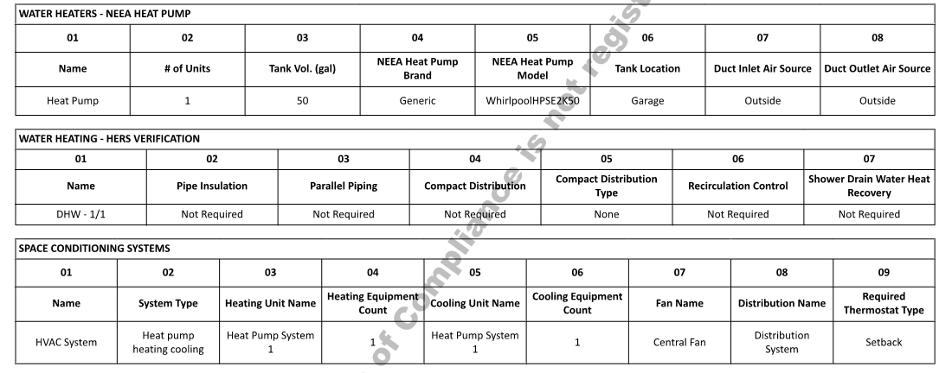
CF1R– Single Family - What to Check?
New Construction? Page 1
Fuel Source for Water Heater and Space Conditioning Page 8 & 9
Fuel Source for Water Heater and Space Conditioning Page 9 & 10

Slide 48
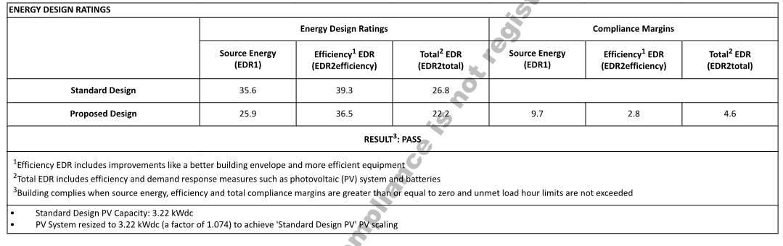
CF1R– Single Family - What to Check?
Source EDR1
House with PV + Battery
Source EDR1 Compliance Margin
Total EDR2 Compliance Margin
House Alone

Slide 49
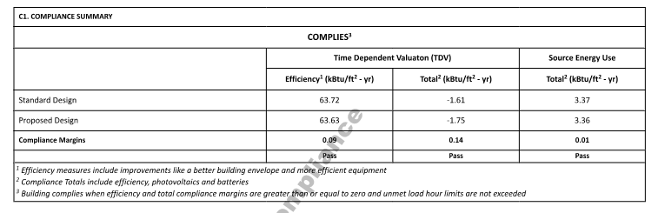
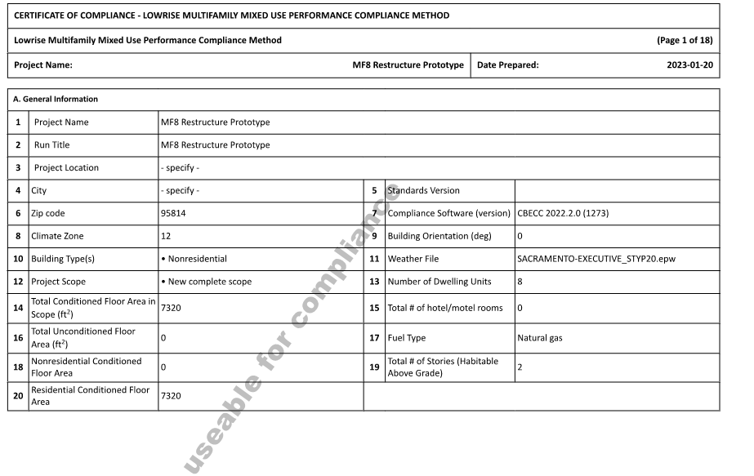
Residential - What to Check?
New Construction? Fuel Source?
TDV - Building With PV and/or Storage
Source Energy Compliance

Slide 50
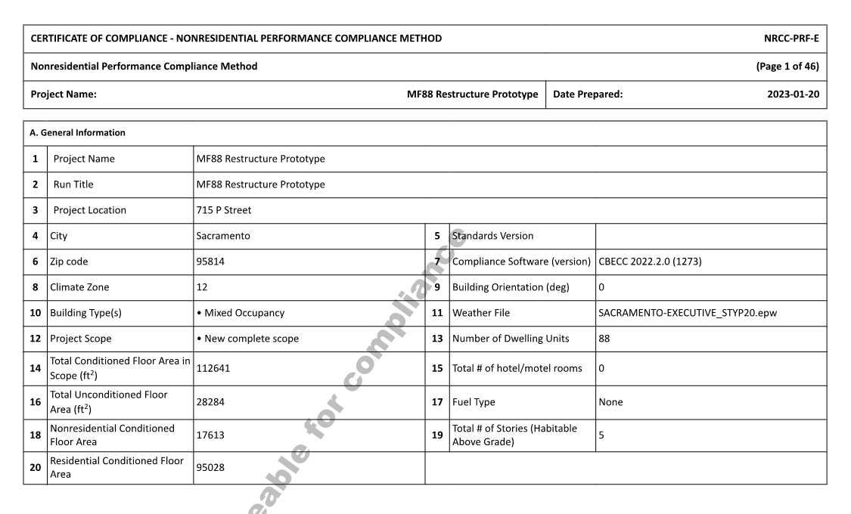
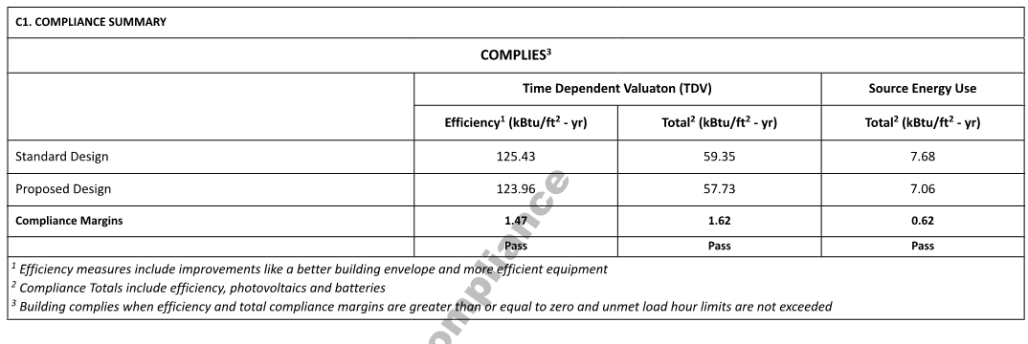
NRCC-PRF-01– High Rise MF/Nonresidential-
What to Check?
New Construction? Fuel Source?
TDV - Building With PV and/or Storage
Source Energy Compliance

Slide 51
Electric- Ready/ Pre-Wiring
Electric- Ready/ Conduit& Capacity
Space Conditioning: Dedicated 208/240V, minimum 30A receptacle
Clothes Dryer: Dedicated 208/240V receptacle with minimum 40A capacity
Cooking: Dedicated 208/240V receptacle with a minimum 50A capacity (code min. 40A circuit)
Multi unit service or common area: Designated Raceway + equivalent electrical panel capacity
Water Heater: Dedicated 240V receptable with minimum 30A capacity and condensate drain

Slide 52
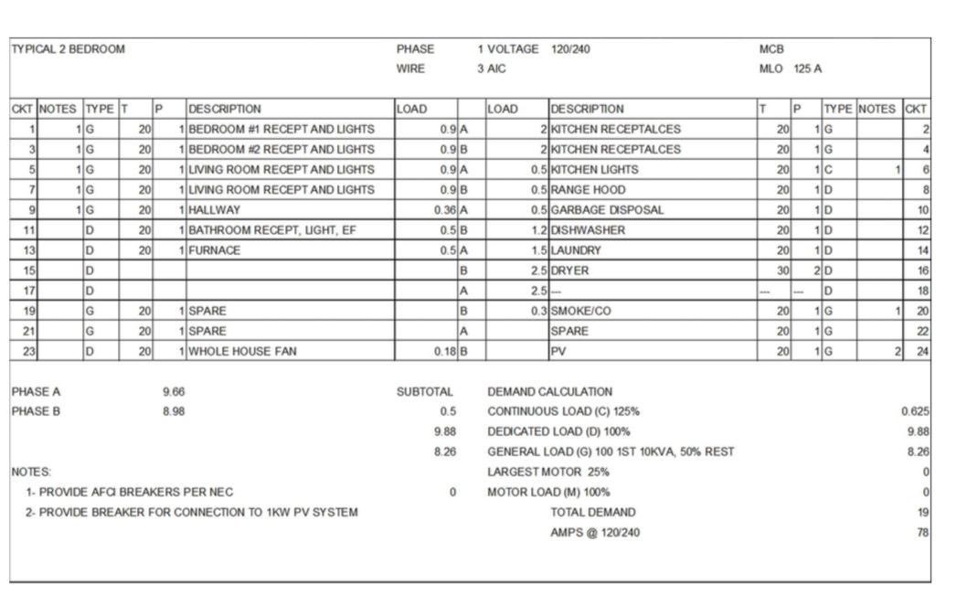
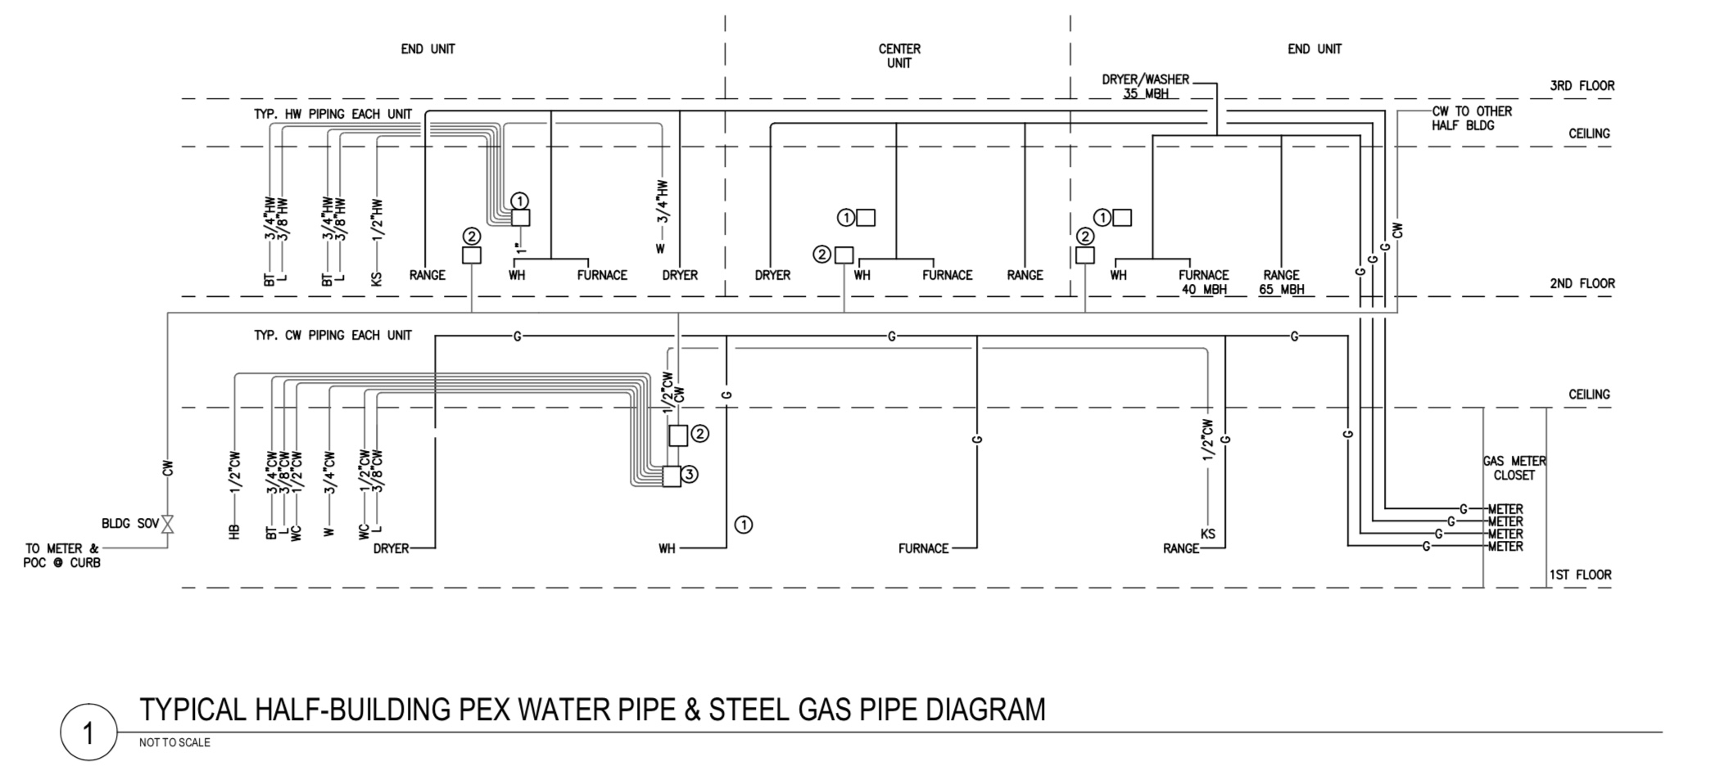
Electric-Ready/ Pre-Wiring
Plumbing & Electrical on Separate Plans
Electrical: panel schedule, plans
Plumbing: piping diagram, load calcs
Example
  Gas line for dryer
  Dryer circuit

Slide 53
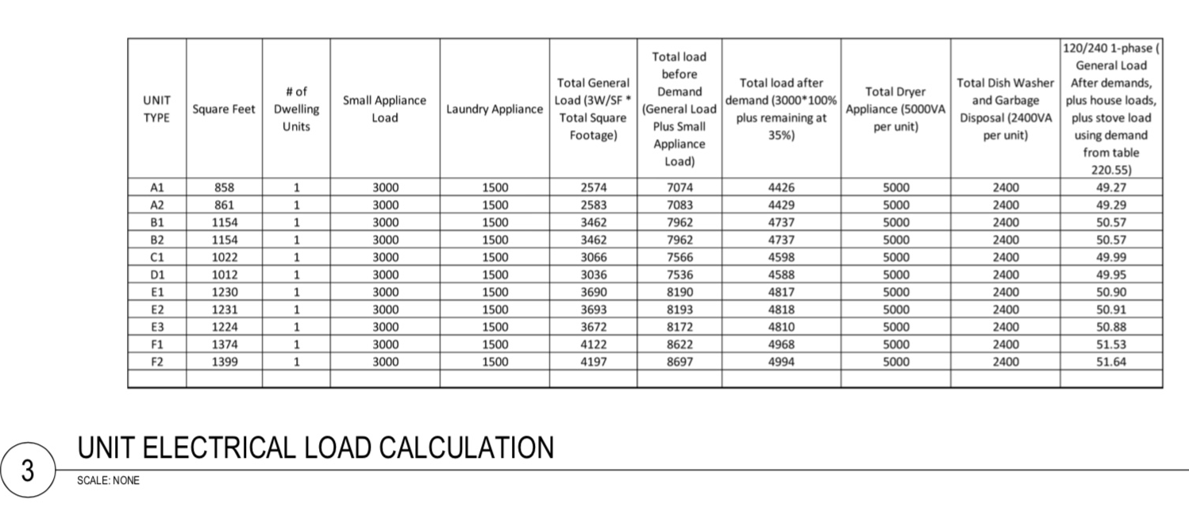
Pre-Wiring- Electrical Capacity
Do calcs include future loads?
Reasonable calculations?
Example: project is installing gas dryers
Notes:
Plan checker may ask for equivalencies for appliances for

Slide 54
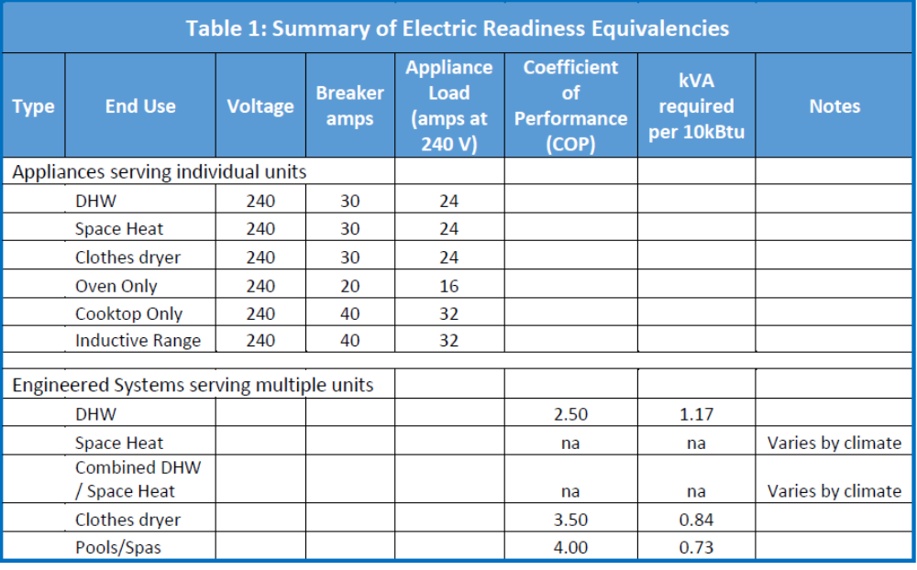
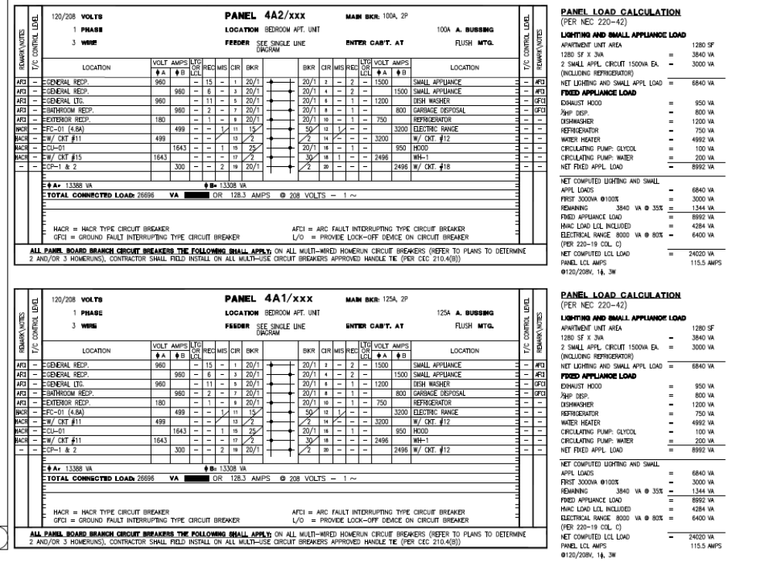
Electrical Capacity
    NOTE: The electrical power required to provide equivalent functionality of the gas-powered equipment as calculated and documented by a licensed design professional associated with the project OR specific equivalencies in ordinance.

Slide 55
Building Inspection

Slide 56
Field Verification– Performance Approach
Performance Threshold
Key components on CF1R/LMCC-PRF-01 and NCC-PRF-01 installed in field
Installer/ HERS forms as appropriate
Insulation levels (attic and walls)
Windows (U-factor and SHGC)
Type of Water heater and HVAC
Notes:
If the reach code uses Total EDR or EE EDR then the metric in performance threshold should be updated

Slide 57
Field Verification– Residential Forms
Installation and HERS Forms
ENV- CF2R/ LMCI/ NRCI - Fenestration, windows, roofing
PLB- CF2R/ LMCI/ NCRA- Hot water distribution
MECH - CF2R/ LMCI/ NCRA – Mechanical systems
ENV - CF3R/ NRCV/ LMCV
MCH - CF3R/ NRCV/ LMCV - Sealed ducts, HVAC, Ventilation
PLB- CF3R/ NRCV/ LMCV- Hot water distribution
PVB- CF2R/ LMCI/NCRA- PV and Battery
Notes:
If the reach code uses Total EDR or EE EDR then the metric in performance threshold should be updated

Slide 58
Electric Infrastructure
Specific Appliance Exception - Prewiring
  Visual verification of receptacles
  Check all appliances or sampling for repeated installations
  Raceway and panel capacity for common or multi-unit appliances
All-Electric
  No gas meter or gas line to building

Slide 59
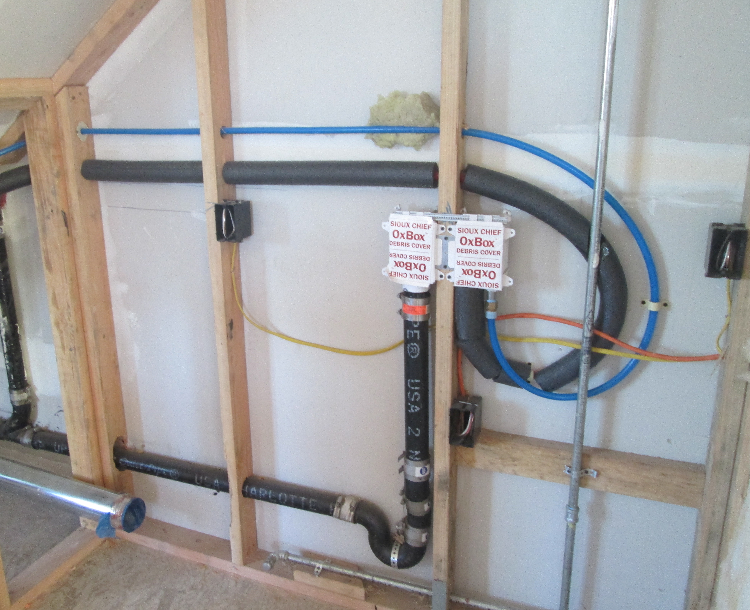
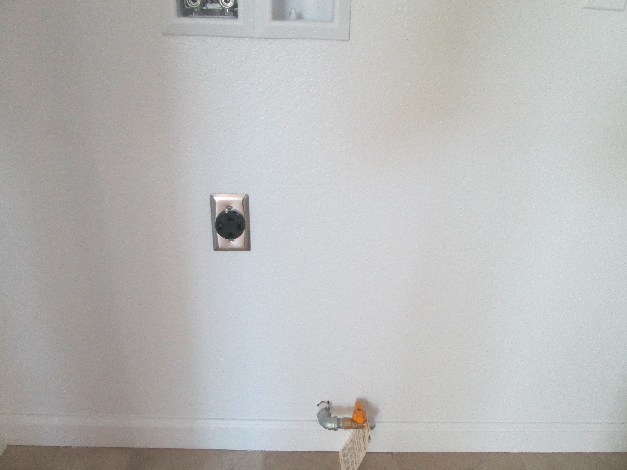
Pre-Wiring – For Any Exceptions
MUST BE verified at rough inspection At final make sure it is not covered
Outlet within 3 ft of gas line

Slide 60
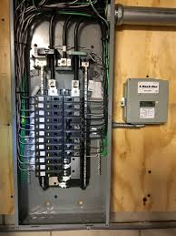
Electric-Ready- Any Exceptions
All Other: Designated Raceway + equivalent panel capacity
Does this match the plans?
  Calculation and loads verified at Plan Review

Slide 61
Exercise- Plan Set Review
You will be unmuted for interactive exercise.
Please mute yourselves when you are not talking.
Notes:
A new multifamily project (apartment building) 2016
A new commercial shell project (office/warehouse) 2016
A TI for the commercial shell project in Item 2 - 2019
A TI of an existing building project (convert retail to assembly) - 2019
Item 1 and 2 were submitted prior to 1/1/2020, so it is under 2016 code (we don’t have any new large projects submitted since the new code cycle as you would expect).
Item 3 and 4 were submitted after 1/1/2020, so it is under 2019 code. All projects are still under review and not approved yet.
Now we are going to work through completing a plan review of a residential and non residential project from your jursidfiction .
We will use Form for Reach Code Compliance to document our work, even though this may not be your tool. It may be potentially submitted by applicant.
Lets divided into two groups
One Residential plan review
One Non-Residential plan review
Document whether or not the plans comply with Electric preferred requirements and where you looked
Then we will come together as a group to review. We will also discuss if the project was all-electric what would you be looking for. What came out of this exercise for you?
Now lets discuss what you would look for in the fields-- Discuss inspections

Slide 62
Exercise
Review [Multifamily Residential Plan Set and Non Residential] Plan Set for Compliance
Review Code
Look at Checklist and Plans together to verify compliance
Discuss Field Verification
Preparation: Can you look at the ppt presentation AND the checklist simultaneously? The checklist can be a hard copy.
Note: The checklist are empty for you to use. These will be submitted by application and there could be discrepancies between this submission and the plans- so use both!
Notes:
For Online trainings, insert slides of sections of plan sets after each Low Rise Residential and the Non Residential slides. The exercise will be a discussion with the team. One team member will lead the discussion using the checklist and discuss what they see on the screen. Each participant should have a printed out checklist in front of them or on a screen where they can see both the images and the checklist.

Slide 63
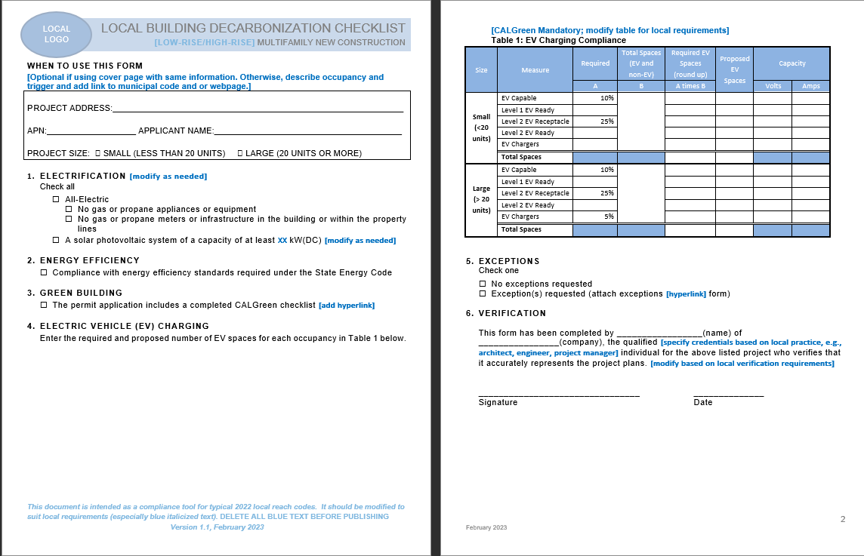
DRAFT
Template Checklists
[Insert image of AHJ Checklist]

Slide 64
Residential and Nonresidential
(Ordinance No.XXX)
Building Type | Performance Path
All-Electric | Proposed/ Built home is all-electric and meets budget in energy code No gas infrastructure installed in building
Note: Prescriptive path may be more common in nonresidential buildings but reach codes will require performance approach to quantify compliance margin.

Slide 65
Residential
(Ordinance No.XXX)
Building Type | Pre-Wire Requirements
Exception | For systems using natural gas or propane, following pre-wire requirements apply: Electric-Ready/Pre-wire dedicated circuit with all conductors and receptacles installed; ends of conductors labeled “For future…”; reserved double pole breaker at panel. Range/Cooktop/ Stand-alone oven– 208/240V 50 amp capacity & receptacle w/in 3 ft of appliance Dryer- 208/240V 40 amp capacity & receptacle w/in 3 ft of appliance Space conditioning– dedicated 208/240V, 30 amp capacity & receptacle w/in 3 ft of future location. Exterior space for outdoor unit and natural drainage or drain for condensate Water Heater– Individual- 240V (3 conductor, 10 AWG), 30 amp capacity & receptacle w/in 3 ft of water heater Multi/common- current space can accommodate future HPWH, condensate drain, raceway and reserved capacity at panel- calcs required.
All-electric or exception?
Plan Review
  For fuel type?
Inspection
  Discuss
Notes:
Pre wire for HPWH for code is 125V 20 amp receptacle – 120/240 3 wire 10 AWG conductor and for future 240V use.

Slide 66
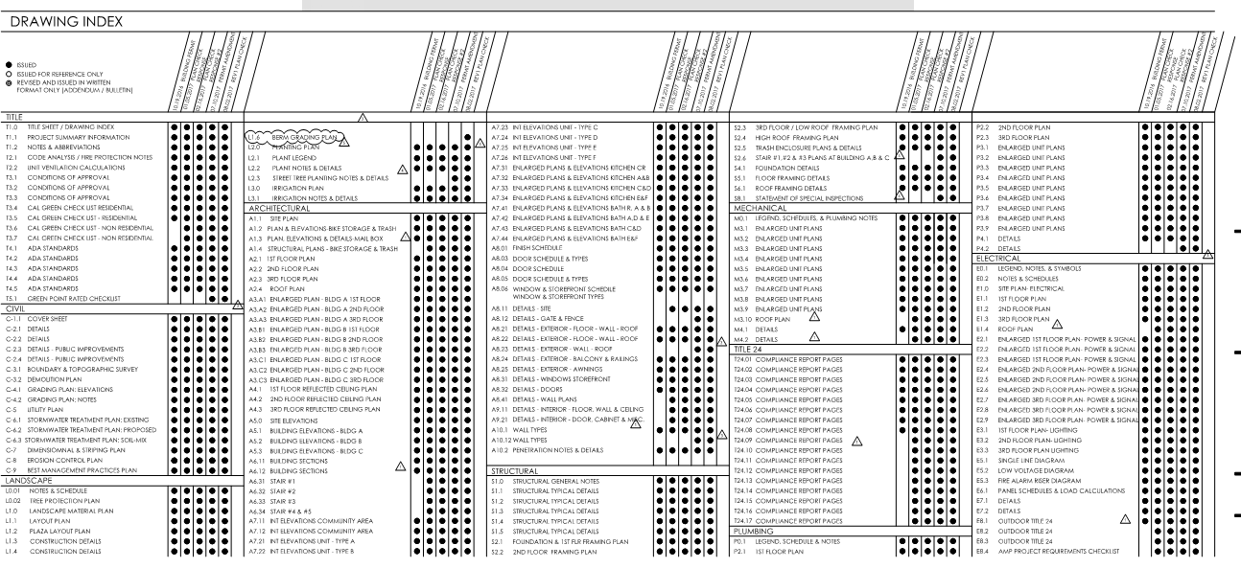
Plan Set - Multifamily

Slide 67
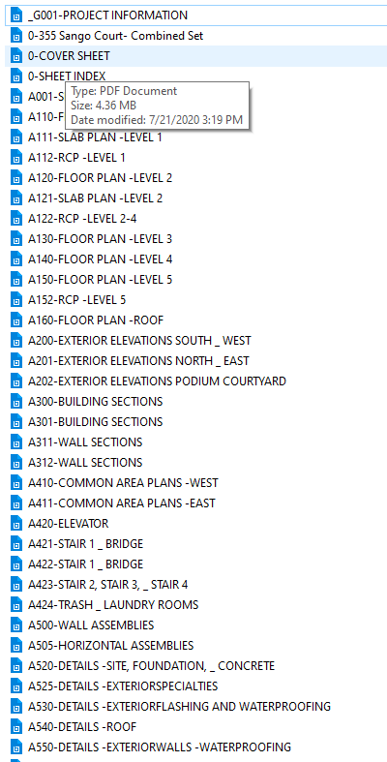
Multifamily Dwelling Unit
–
Project type?
Fuel Type?
Where would you look first?
Mechanical Plans
Site Plan
Energy Compliance
Project Summary
Plumbing Plans

Slide 68
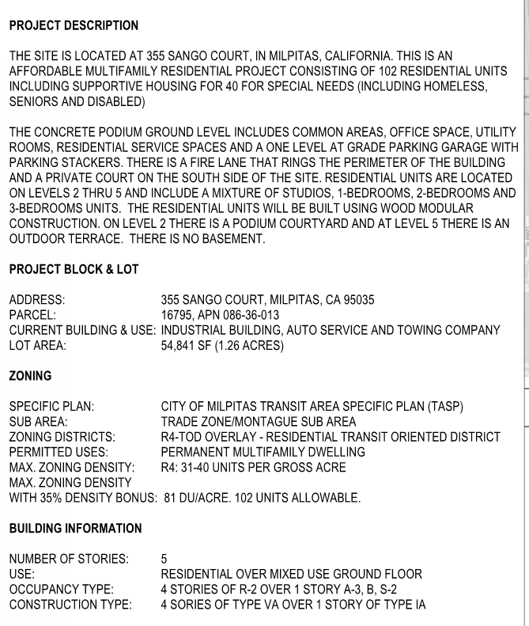
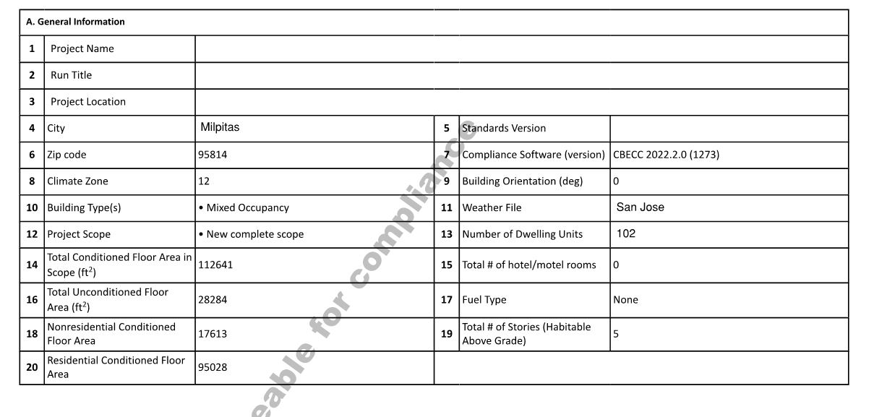
General Project Page
Energy Compliance Page

Slide 69
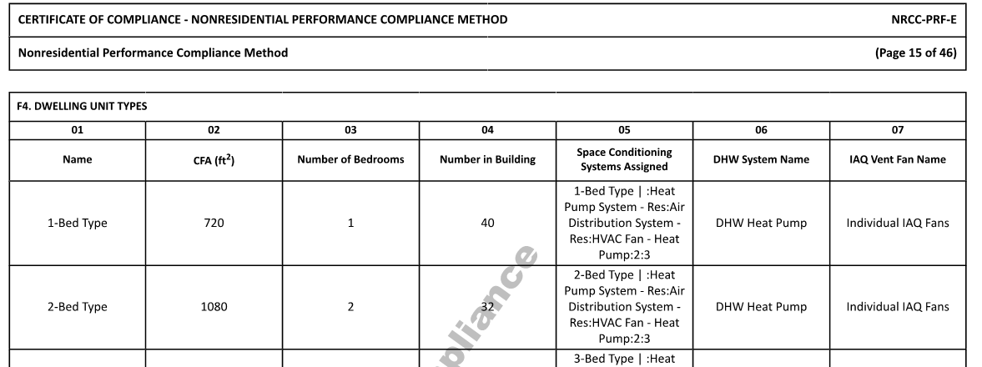
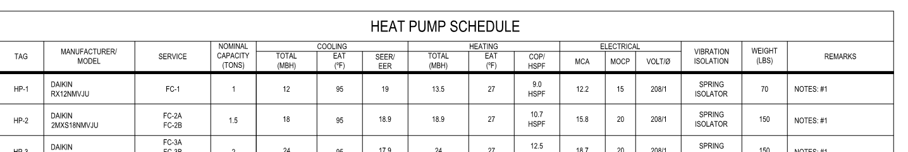
Fuel Type for Space and Water Heating?
Energy Compliance Page
Mechanical Schedule

Slide 70
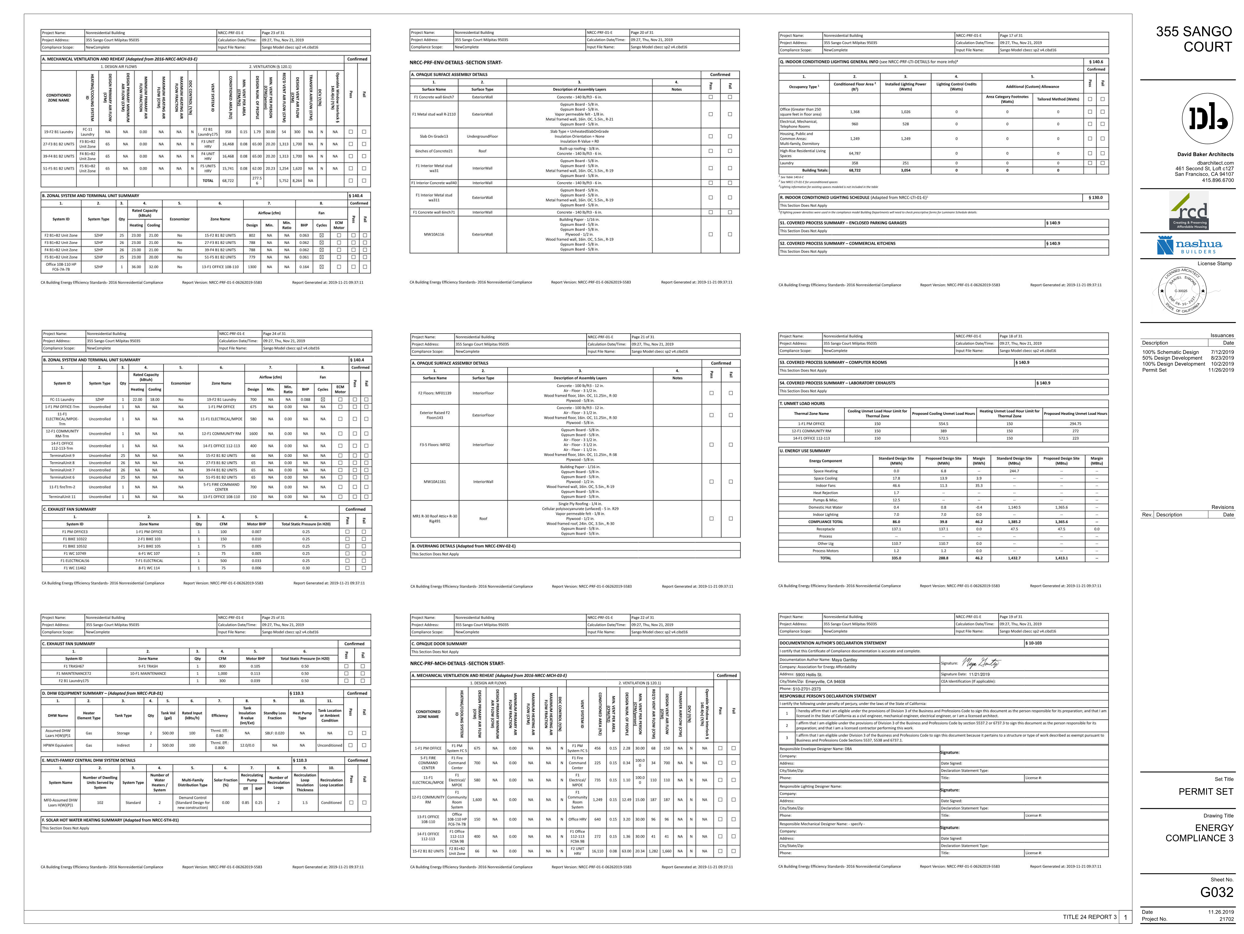

Slide 71
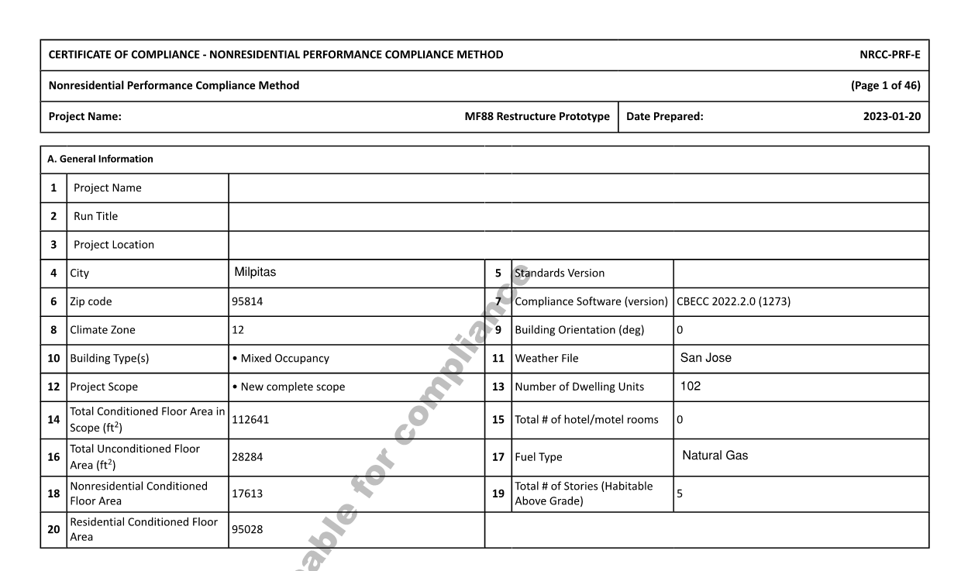
What if Natural Gas is Identified?

Slide 72
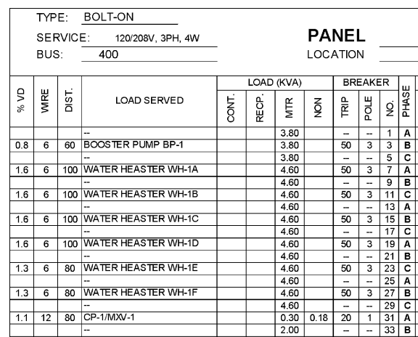
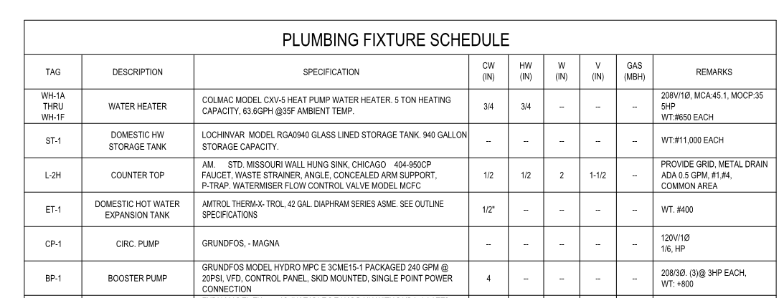
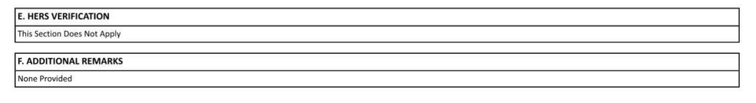
Systems that Cannot be Modeled?
Best practice: Include Additional Remarks: “This project was modeled according to CEC guidance for compliance. The actual Water heater is a heat pump and solar thermal has been removed.

Slide 73
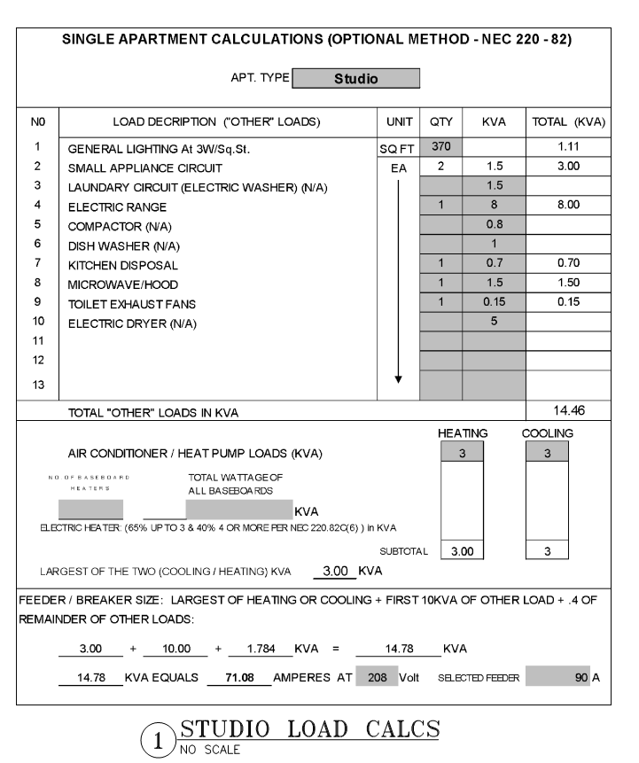

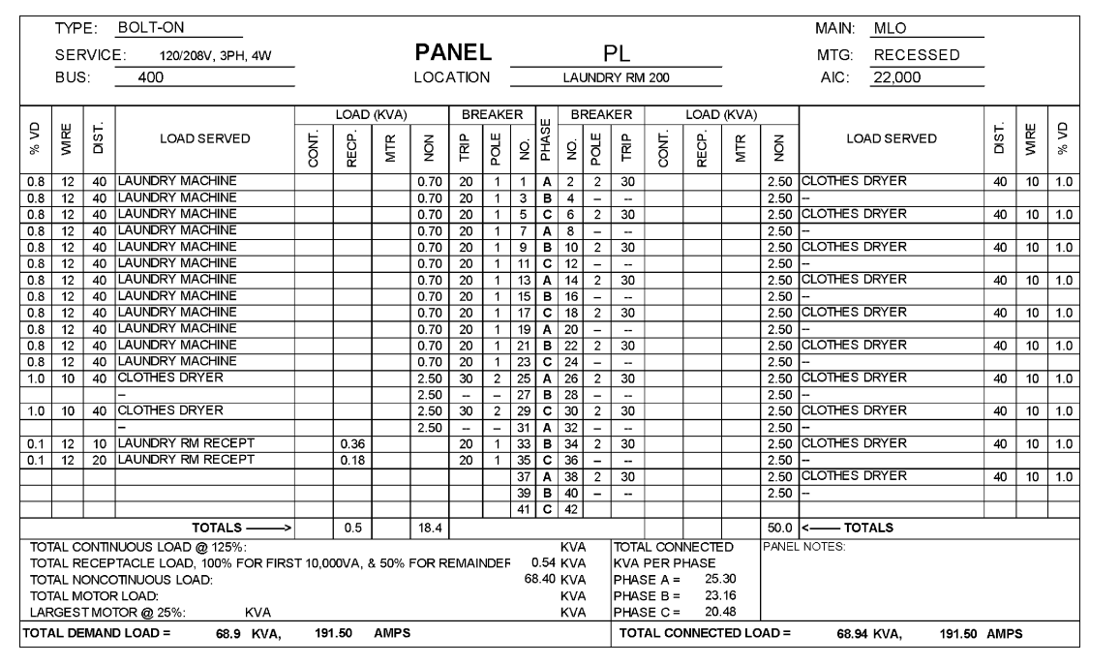
If Natural Gas/ Propane Appliances Installed
Pre- Wire – (Prescriptive/Performance)
Electric Appliances Accounted for in Load Calculations

Slide 74
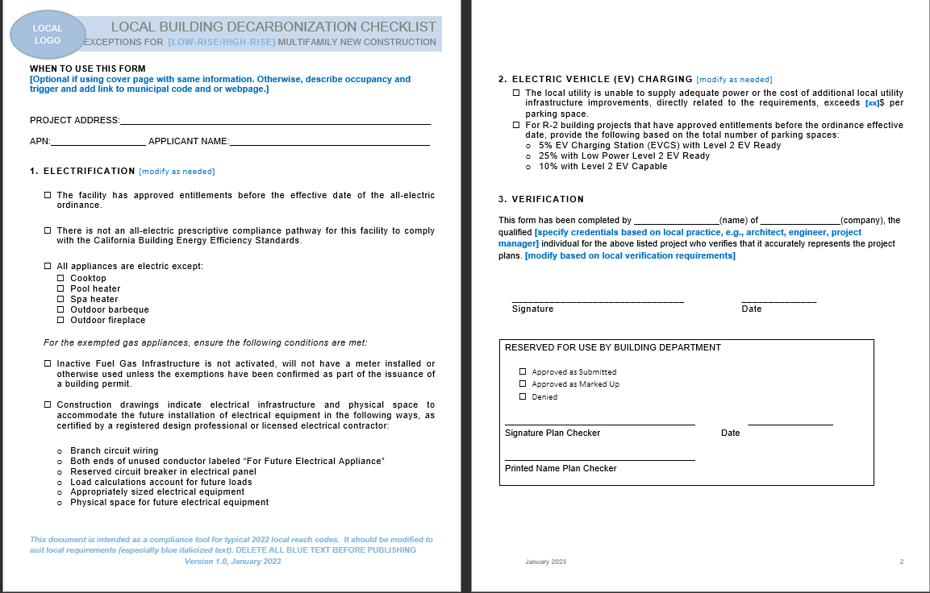
If Natural Gas/ Propane Appliances Installed
Require exception document indicating which appliances are exempt and conditions.

Slide 75
Questions on
Multifamily Residential Building Electrification Code?

Slide 76
Single Family Residential

Slide 77
Reach Code Requirements
–
Single Family and Multifamily and Free Standing ADUs and Additions (incl. attached ADUs)
(Ordinance No.XXXX)
Building Type | Performance Path
All-Electric | Proposed/ Built home meets energy code and is all-electric No gas infrastructure installed in building
Notes:
The metric should be updated for the specific metric for the reach code. On this slide is Total EDR Margin Other metrics include Total EDR or EE EDR Margin. The potential threshold are listed below.
Proposed/ Built project shall have a Total EDR Margin of [6,8,9,10] OR Total EDR [5,8,10,11,12,13,15,22,23] or EE EDR Margin of [ 0,1,2,3,4,5] for single family
Proposed/ Built project shall have a Total EDR Margin of [6,8,9,10] OR Total EDR [5,8,10,11,12,13,15,22,23]

Slide 78
Reach Code Requirements
–
Single Family and Multifamily and Free Standing ADUs and Additions (incl. attached ADUs)
(Ordinance No.XXXX)
Building Type | Pre Wire Requirements
Exceptions | For systems using natural gas or propane, following pre-wire requirements apply: Electric-Ready/Pre wire- dedicated circuit with all conductors and receptacles installed; ends of conductors labeled “For future..”; reserved double pole breaker at panel. Range/cooktop – 208/240V 50 amp capacity & receptacle w/in 3 ft of appliance Dryer- 208/240V 40 amp capacity & receptacle w/in 3 ft of appliance Space conditioning– dedicated 208/240V, 30 amp capacity & receptacle w/in 3 ft of future location. Exterior space for outdoor unit and natural drainage or drain for condensate Water Heater– Individual- 240V (3 conductor, 10 AWG), 30amp capacity & receptacle w/in 3 ft of water heater Multi/common- current space can accommodate future HPWH, condensate drain, raceway and reserved capacity at panel- calcs required.
Notes:
Pre wire for HPWH for code is 125V 20 amp receptacle – 120/240 3 wire 10 AWG conductor and for future 240V use.

Slide 79
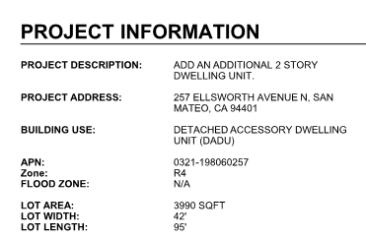
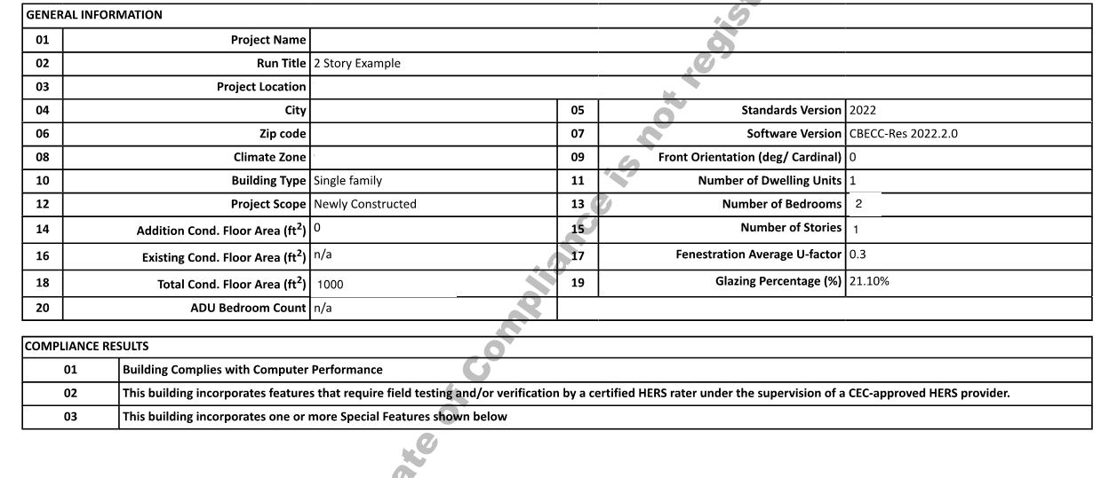
Low Rise Residential –
Project type?

Slide 80
What is reach code requirement?
To Code
OR
Exception
OR
Non Compliant

Slide 81
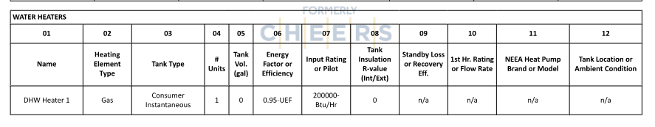
Fuel type in building?
Mixed-fuel or all electric?
Fuel type for Space and Water Heating?
Combined Hydronic- Space Heating is gas too

Slide 82

Pre Wire – Prescriptive and Performance
Plan Review
No electrical panel schedule
No single line diagram
No future load calcs
Field Inspection
Verify pre wire or electric ready
X

Slide 83

If it was All-electric….
Need to look at system type to see fuel type in SF

Slide 84
Questions on
Single Family and Multifamily Residential?

Slide 85
Buildings – All Electric Additions and Alterations Reach Code Overview

Slide 86
Residential Covered Projects:
A project in a Single family or Multifamily residential building originally permitted for construction before 2011 that requires an electrical permit, a mechanical permit and a plumbing permit. [This is an example of one definition of the threshold for when a project is deemed new construction. Edit with appropriate trigger]

Slide 87
Definitions
[Add appropriate definitions]

Slide 88
Reach Code Requirements
–
Single Family, Multifamily Additions and Alterations (incl. attached ADU)
(Ordinance No.XXXX)
Scope of Work | Replacement Requirements
AC and Water Heater Replacements Panel Upgrades | Install Heat pump for heating and cooling or water heating when replacing gas or propane appliance Upgrade panel to support all-electric for future loads for gas fired appliances and include EV charging.
Notes:
Pre wire for HPWH for code is 125V 20 amp receptacle – 120/240 3 wire 10 AWG conductor and for future 240V use.

Slide 89
Reach Code Requirements
–
Single Family, Multifamily Additions and Alterations (incl. attached ADU)
(Ordinance No.XXXX)
Scope of Work | Replacement Requirements
Kitchen and Laundry Renovations | Pre wire for electric dryer or range: Dedicated circuit with all conductors and receptacles installed; ends of conductors labeled “For future..”; reserved double pole breaker at panel. Range/cooktop – 208/240V 50 amp capacity & receptacle w/in 3 ft of appliance Dryer- 208/240V 40 amp capacity & receptacle w/in 3 ft of appliance
Notes:
Pre wire for HPWH for code is 125V 20 amp receptacle – 120/240 3 wire 10 AWG conductor and for future 240V use.

Slide 90
Plus Energy Efficiency: for Single Family and Multifamily
Install required energy efficiency measures
  Compliance with State Energy Code requirements
  All lighting is LED
  All exterior lights are on a photocell
  Ducts have been sealed and verified by a HERS Rater

Slide 91
Plus Energy Efficiency: for Single Family and Multifamily
Single Family
Comply with SF Flex Path Checklist - Energy Standards Checklist
  Mandatory measures as defined
  Select measures to achieve target score
Multifamily
Install required energy efficiency measures
  Compliance with State Energy Code requirements
  All lighting is LED
  All exterior lights are on a photocell
  Ducts have been sealed and verified by a HERS Rater

Slide 92

Flex Path Checklist
Identify Target Score by vintage and climate zone
Specified mandatory measures
Menu of measures to achieve target score
Menu/ points/ and target will vary by climate zone

Slide 93


SF Flex Path Checklist

Slide 94
Exceptions – Single family and Multifamily[edit and delete exceptions]
Not Feasible
Determined on a case-by-case basis if compliance margin is not feasible. Burden on applicant to demonstrate.
Outdoor Appliance
Outdoor fireplaces or barbeques or pool/ spa heater are allowed to be supplied with propane or natural gas. Limits gas in building only.
Higher Performing
The proposed building is less than or equal to Energy Budget under project if it included any set of measures in SF Flex Path
Specific building
Not In Permitted Scope
The specified appliance or equipment in reach code is not being altered
Mobile home, manufactured housing or factory-built housing

Slide 95
Exceptions – Non Residential [edit and delete exceptions]
Not Feasible
Determined on a case-by-case basis if compliance margin is not feasible. Burden on applicant to demonstrate.
Electrical Panel Upgrade
Buss bar capacity will exceed proposed electrical service; EV Charging will share circuit; Panel has internet connected overcurrent protection
Water Heating
Gas WH serves > 500 square ft in constrained space; Serves a pool; Demand over 500 gal/day; Connected to solar hot water system; Inside conditioned space
Space Conditioning
Not In Permitted Scope
The specified appliance or equipment specified in reach code is not be altered
Space cooling appliance is greater than 360,00 Btu/h

Slide 96
Compliance

Slide 97
Checklist Submission vs. Department Verification
Applicant Checklist Submission
  Attesting to reach code compliance
Plan Review
  Verifying specific element and CF1R/ LMCC- PRF-01/ NRCC-PRF-01
Field Inspection
  Verifying specific elements
  CF2R/LMCI/NRCA/NRCCs and CF3R/LMCA/NRCVs and HERS registry: Building dept access and Project Status Report
Less forms for existing buildings
Notes:
mention special building department access, Project Status Report (PSR), and "all green dots". (Field Inspection notes)

Slide 98
Compliance Process
Applicant
SUBMIT PLANS AND FORM DEMONSTRATING COMPLIANCE
Plan Check
VERIFY SPECIFIC ELEMENTS
Field Inspection
VERIFY SPECIFIC ELEMENTS
FINAL TITLE 24 DOCUMENTATION & CF2R/LMCI/NRCA/NRCCs and CF3R/LMCA/NRCVs -HERS DOCUMENTATION (Online HERS Registry)
CF1R/LMCC- PRF-01/NRCC-PRF-01
CF1R/LMCC- PRF-01/NRCC-PRF-01
Notes:
mention that the energy code docs exist in electronic format are readily accessible on line via HERS registry.

Slide 99
All Electric Plan Review- Existing

Slide 100


Form for Reach Code Compliance on the Plans
Notes:
Low Rise Residential Checklist: https://localenergycodes.com/download/1456/file_path/fieldList/2019%20Low-rise%20Residential%20Checklist.docx
High Rise Residential Checklist: https://localenergycodes.com/download/1457/file_path/fieldList/2019%20High-Rise%20Residential%20Checklist.docx
Nonresidential Checklist: https://localenergycodes.com/download/1458/file_path/fieldList/2019%20Nonresidential%20Checklist.docx

Slide 101


Form for Reach Code Compliance for SF Flex Path on the Plans
Notes:
Low Rise Residential Checklist: https://localenergycodes.com/download/1456/file_path/fieldList/2019%20Low-rise%20Residential%20Checklist.docx
High Rise Residential Checklist: https://localenergycodes.com/download/1457/file_path/fieldList/2019%20High-Rise%20Residential%20Checklist.docx
Nonresidential Checklist: https://localenergycodes.com/download/1458/file_path/fieldList/2019%20Nonresidential%20Checklist.docx

Slide 102
2022 Energy Code –Documenting Compliance for Additions and Alterations
Regardless of the scope of the project or the compliance pathway (prescriptive or performance), compliance is documented using at least two types of certificates:
  CF1R/ LMCC-PRF01/ NRCC-PRF01 – Certificate of Compliance – Documents what is required
  CF2R/ LMCI/ NRCA – Certificate of Installation – Documents what is installed
The CF3R/ LMCC/ NRCV is only required when 3rd-party HERS verification is required.

Slide 103


Forms for Alterations and Additions
Different form numbers
Forms for HERS and Non-HERS verification

Slide 104


Form for Prescriptive- Alterations- Single Family
Forms- CF1R & CF2R-ALT-05 (Non-HERS)
Notes:
The CF1R-ALT-05 and the CF2R-ALT-05 are very similar.

Slide 105


Prescriptive- Alterations
Plan Review
  CF1R-ALT- 05 - prepared by an energy consultant describes type of water heater.
    The same type water heater must be installed with equal or better efficiency
Field Documentation
  The installed unit will be documented on either a
    CF2R-ALT-05 (Non-HERS) or
    CF2R-PLB-02 (Non-HERS) or CF2R-PLB-22 (HERS)
  Building Inspector should verify installed HPWH
Notes:
If the reach code uses Total EDR or EE EDR then the metric in performance threshold should be updated

Slide 106

Form for Prescriptive – Additions <1,000sf
CF1R-ADD-02- E Prescriptive - Non-HERS
Notes:
The CF1R-ADD-02 and the CF2R-ADD-02 are very similar. This is a Non-HERS registered form.

Slide 107
Electric- Ready/ Pre-Wiring
Electric- Ready/ Conduit& Capacity
Clothes Dryer: Dedicated 208/240V receptacle with minimum 40A capacity
Cooking: Dedicated 208/240V receptacle with a minimum 50A capacity (code min. 40A circuit)
Panel Capacity: Upgraded panel accommodates all- electric appliances
Multi unit service or common area: Designated Raceway + equivalent electrical panel capacity

Slide 108
Electric-Readiness/ Pre-Wiring
Plumbing & Electrical on Separate Plans
Electrical: panel schedule, plans
Plumbing: piping diagram, load calcs
Example
  Gas line for dryer
  Dryer circuit

Slide 109
Pre-Wiring- Electrical Capacity
Do calcs include future loads?
Reasonable calculations?
Example: project
is installing gas dryers
Notes:
Plan checker may ask for equivalencies for appliances for

Slide 110
Electrical Capacity
    NOTE: The electrical power required to provide equivalent functionality of the gas-powered equipment as calculated and documented by a licensed design professional associated with the project OR specific equivalencies in ordinance.

Slide 111
Building Inspection

Slide 112
Field Verification– Additions and Alterations
Additions and Alterations
Key components on CF1R/ LMCC - PRF-01/ NCC-PRF-01- installed in field
Installer/ HERS forms as appropriate
Specific Appliance triggered - Type of Water heater and HVAC
Pre-wiring depending on SOW
Notes:
If the reach code uses Total EDR or EE EDR then the metric in performance threshold should be updated

Slide 113
Field Verification– Residential Forms
Installation and HERS Forms
ENV- CF2R/ LMCI/ NRCI - Fenestration, windows, roofing
PLB- CF2R/ LMCI/ NCRA- Hot water distribution
MECH - CF2R/ LMCI/ NCRA – Mechanical systems
ENV - CF3R/ NRCV/ LMCV
MCH - CF3R/ NRCV/ LMCV - Sealed ducts, HVAC, Ventilation
PLB- CF3R/ NRCV/ LMCV- Hot water distribution
PVB- CF2R/ LMCI/NCRA- PV and Battery
Notes:
If the reach code uses Total EDR or EE EDR then the metric in performance threshold should be updated

Slide 114
Electric Infrastructure
Specific Appliance Exception – Pre-wiring
    Visual verification of receptacles
    Check all appliances or sampling for repeated installations
    Raceway and panel capacity for common or multi-unit appliances
    No extension of gas line

Slide 115
Pre-Wiring – For Any Exceptions
MUST BE verified at rough inspection At final make sure it is not covered
Outlet within 3 ft of gas line

Slide 116
Electric-Ready- Any Exceptions
All Other: Designated Raceway + equivalent panel capacity
Does this match the plans?
  Calculation and loads verified at Plan Review

Slide 117
Exercise- Plan Set Review
You will be unmuted for interactive exercise.
Please mute yourselves when you are not talking.
Notes:
A new multifamily project (apartment building) 2016
A new commercial shell project (office/warehouse) 2016
A TI for the commercial shell project in Item 2 - 2019
A TI of an existing building project (convert retail to assembly) - 2019
Item 1 and 2 were submitted prior to 1/1/2020, so it is under 2016 code (we don’t have any new large projects submitted since the new code cycle as you would expect).
Item 3 and 4 were submitted after 1/1/2020, so it is under 2019 code. All projects are still under review and not approved yet.
Now we are going to work through completing a plan review of a residential and non residential project from your jursidfiction .
We will use Form for Reach Code Compliance to document our work, even though this may not be your tool. It may be potentially submitted by applicant.
Lets divided into two groups
One Residential plan review
One Non-Residential plan review
Document whether or not the plans comply with Electric preferred requirements and where you looked
Then we will come together as a group to review. We will also discuss if the project was all-electric what would you be looking for. What came out of this exercise for you?
Now lets discuss what you would look for in the fields-- Discuss inspections

Slide 118
Exercise
Review [Single Family Plan Set and Multifamily] Plan Set for Compliance
Review Code
Look at Checklist and Plans together to verify compliance
Discuss Field Verification requirements
Preparation: Can you look at the presentation AND the checklist simultaneously? The checklist can be a hard copy.
Note: The checklists are empty for you to use. These will be submitted by application and there could be discrepancies between this submission and the plans- so use both!
Notes:
For Online trainings, insert slides of sections of plan sets after each Low Rise Residential and the Non Residential slides. The exercise will be a discussion with the team. One team member will lead the discussion using the checklist and discuss what they see on the screen. Each participant should have a printed out checklist in front of them or on a screen where they can see both the images and the checklist.

Slide 119

DRAFT
Template Checklists
[Insert image of AHJ Checklist]

Slide 120
Reach Code Requirements
–
Single Family, Multifamily Additions and Alterations (incl. attached ADU)
(Ordinance No.XXXX)
Scope of Work | Replacement Requirements
AC and Water Heater Replacements Panel Upgrades | Install Heat pump for heating and cooling or water heating when replacing gas or propane appliance Upgrade panel to support all-electric for future loads for gas fired appliances and include EV charging.
Notes:
Pre wire for HPWH for code is 125V 20 amp receptacle – 120/240 3 wire 10 AWG conductor and for future 240V use.

Slide 121
Reach Code Requirements
–
Single Family, Multifamily Additions and Alterations (incl. attached ADU)
(Ordinance No.XXXX)
Scope of Work | Replacement Requirements
Kitchen and Laundry Renovations | Pre-wire for electric dryer or range: Dedicated circuit with all conductors and receptacles installed; ends of conductors labeled “For future..”; reserved double pole breaker at panel. Range/cooktop – 208/240V 50 amp capacity & receptacle w/in 3 ft of appliance Dryer- 208/240V 40 amp capacity & receptacle w/in 3 ft of appliance
Notes:
Pre wire for HPWH for code is 125V 20 amp receptacle – 120/240 3 wire 10 AWG conductor and for future 240V use.

Slide 122


Reach Code Requirements
–
Single Family, Multifamily Additions and Alterations (incl. attached ADU)
(Ordinance No.XXXX)

Slide 123



Schedules
Mechanical, Plumbing and Electrical schedules show all-electric
Note: be sure to look at panel for common loads: laundry and unit panel for individual loads panel and unit panel

Slide 124
Electric Vehicle Charging

Slide 125
Definitions

Slide 126
Electric Vehicle – Definitions
Speed
Readiness
Number

Slide 127








Electric Vehicle – Definitions
Speed
Readiness
Number
EV Capable
Level 1
“Trickle Charging”
Percent of Parking Spaces
Level 2
“Standard Charging”
Level 3
“DC Fast / SuperCharging”
EV Charging Station
…OR…Spaces per Dwelling Unit
127

Slide 128


Electric Vehicle – Definitions
Speed
Readiness
Number
EV Capable
Level 1
“Trickle Charging”
Percent of Parking Spaces
Level 2
“Standard Charging”
EV Ready
Level 3
“DC Fast / SuperCharging”
EV Charging Station
…OR…Spaces per Dwelling Unit
128

Slide 129
Electric Vehicle – Definitions
Speed
Readiness
Number
EV Capable
Level 1
“Trickle Charging”
Percent of Parking Spaces
Level 2
“Standard Charging”
EV Ready
Level 3
“DC Fast / SuperCharging”
EV Charging Station
…OR…Spaces per Dwelling Unit
129

Slide 130
Electric Vehicle – Definitions
Speed
Readiness
Number
EV Capable
Level 1
“Trickle Charging”
Percent of Parking Spaces
Level 2
“Standard Charging”
EV Ready
Level 3
“DC Fast / SuperCharging”
EV Charging Station
…OR…Spaces per Dwelling Unit
130
Notes:
624.14 Electric vehicle charging loads shall be considered to be continuous loads. Where an automatic load management system is used, the maximum electric vehicle supply equipment load on a service or feeder shall be the maximum load permitted by the automatic load management system.

Slide 131
Low Power Level 2
“Low Power Level 2 EV Ready” shall mean a parking space that is served by a complete electric circuit with the following requirements:
  A minimum of 4.1 kVA (208/240 volt, 20-ampere) capacity wiring.
  A receptacle labeled “Electric Vehicle Outlet” or electric vehicle supply equipment located within three (3) feet of the parking space. If EVSE is provided the minimum capacity of the EVSE shall be 16-ampere.
  Conduit oversized to accommodate future Level 2 EV Ready (208/240 volt, 40-ampere) at each parking space.

Slide 132

Automated Load Management System (ALMS)
Circuit Sharing Example
7.2kW

Slide 133
Automated Load Management System (ALMS)
Circuit Sharing Example
7.2kW
3.6kW
3.6kW

Slide 134
Automated Load Management System (ALMS)
Circuit Sharing Example
7.2kW
3.6kW
3.6kW
1.8kW
1.8kW
1.8kW
1.8kW

Slide 135
Automated Load Management System (ALMS)
Circuit Sharing Example
Benefits
  Decrease in electrical system capital costs
  Reduces peak demand on grid
Types of ALMS
  Circuit Sharing
  Panel Sharing
  Transformer Sharing
Current Status
  Allowed by some Reach Codes
  Technology is readily available
  Most Level 3 stations already implement ALMS
  Loosely defined in 2020 NEC
  Not defined in the 2019 California Building Code
7.2kW
3.6kW
3.6kW
1.8kW
1.8kW
1.8kW
1.8kW

Slide 136
What is Already Included in Title 24?

Slide 137
2022 CALGreen EV Infrastructure
New Construction AND Alterations to Multifamily Parking
Building Type | Quantity | Readiness | Charging Speed
Single Family | 1 per dwelling unit | Capable | Level 2
All Multifamily | 10% of total spaces 20% of total spaces | Capable EV Ready | Level 2 Low power Level 2
Multifamily w/ > 20 dwelling units | 5% of total spaces | EV Ready | Level 2 EVSE
Multifamily adding parking spaces | 10% of total added/ altered spaced | EV capable | Level 2
Nonresidential | Based on parking space ~15-30% | EV capable | Level 2
Notes:
The 2022 code also added “new residential parking facilities” into this section of the code.
The CalGreen Code separates this category into two groups – those buildings with less than 20 dwelling units and those with 20 dwelling units or more.

Slide 138
EV Reach Code Overview

Slide 139




EV Reach Code – Single Family and Townhouses
Reach Code- Alterations (Ordinance No.XXX) | Reach Code- New (Ordinance No.XXX)
 | `
1 and 2 family dwellings and townhouses with attached private garages
1- Level 2 EV Ready circuit
1- Level 1 EV Ready circuit
(1) Level 2 EV Capable for one parking space per dwelling unit when adding parking space or garages
ELECTRIC
VEHICLE
OUTLET

Slide 140
EV Reach Code – Multifamily
Reach Code Alterations (Ordinance No.XXXX) | Reach Code New Construction (Ordinance No.XXXX)
≤ 20 spaces
> 20 spaces
10%
20%
35%
35%
15%
45%
50%
10% Altered or added parking space are EVCS with Level 2 EV Ready
Existing EV Capable are upgraded to EV Ready
35% Level 2 EV Ready Circuit
20% Low Power Level 2
EV Ready Circuit
Affordable housing
35% Level 2 EV Ready Circuit
5% Low Power Level 2 EV Ready Circuit
35% Level 1 EV Ready Circuit
15% Low Power Level 2
EV Ready Circuit
Affordable housing
15% Level 1 EV Ready Circuit
10% Low Power Level 2
EV Ready Circuit

Slide 141
EV Reach Code –Hotel/ Motel
Reach Code Alterations (Ordinance No.XXXX) | Reach Code New Construction (Ordinance No.XXXX)
≤ 20 spaces
> 20 spaces
10%
10%
25%
25%
10%
5%
5%
60%
60%
10% Altered or added parking space are EVCS with Level 2 EV ready.
Existing EV Capable are upgraded to EV Ready.
25% Low Power Level 2
EV Ready
10% Level 2 EV Capable Circuit
5% Level 2 EV Ready Circuit
25% Low Power Level 2
EV Ready
10% Level 2 EV Capable Circuit
5% Level 2 EV Ready Circuit

Slide 142
EV Reach Code – Nonresidential
Reach Code Alterations (Ordinance No.XXX) | Reach Code New (Ordinance No.XXX)
Office Buildings
Other Occupancies
4%
20%
3%
10%
30%
20 % Level 2 EVSC (charging syst.)
30 % Level 2 Capable or EV Ready
4 % Level 2 EVSC (charging syst.)
3 % Level 2 Capable or EV Ready
> 100 Spaces: option for 1 80kW fast charge per 100 spaces
10 % of added/ altered parking spaces Level 2 Ready and EVSC (charging syst.)
X % of EV Capable required spaces upgrades to Level 1 EV Ready
% of all parking spaces
Note: 80kW fast charger equivalent to 6 Level 2 EVCS and 5 EV Ready spaces after a minimum of 6 Level 2 EVCS and 5 Level 1 EV Capable spaced installed

Slide 143
Exceptions
Not Feasible
Determined on a case-by-case basis if compliance margin is not feasible OR No commercial power supply
Accessibility
EVCS: EV spaces required by Section 4.106.4.2.2 shall comply with CH 11A or on accessible route
EVCS required by CH 11B not required to comply with section 4.106.4.2.1 and 4.106.4.2.2
Design
Parking Space Dimensions:
Min length: 18ft
Min width: 9 ft
1 in every 25 spaces accessible
Notes:
This is Berkeley. Windsor is just low rise residential.

Slide 144
EV Reach Code – Allows Automated Load Management
Allows ALMS for:
  Circuit sharing
  Panel sharing
  Transformer sharing
  Level 1 & 2
  EV-ready & EV Charging Stations
Minimum Power Output 1.4kW per Station or Outlet
7.2kW
3.6kW
3.6kW
1.8kW
1.8kW
1.8kW
1.8kW

Slide 145
EV Plan Review and Inspection

Slide 146


EV – Plan Review
Review requirements on worksheet submitted by applicant
  Speed
  Readiness
  Number
Check plans to count if it meets requirements

Slide 147


EV – Inspection
Ensure installed equipment matches drawings

Slide 148


Automated Load Management System
Confirm circuiting matches plans
Ensure load management is installed:
  ALMS-capable EV Charging Stations
  Special ALMS device for EV-ready outlets

Slide 149
Electric Vehicles Exercise
Review Multifamily Residential Plan Set and Nonresidential Plan Set for Compliance
Review Code
Look at Checklist and Plans together to verify compliance
Discuss Field Verification
Preparation: Can you look at the presentation AND the checklist simultaneously? The checklist can be a hard copy.
Note: The checklists are empty for you to use. These will be submitted by application and there could be discrepancies between this submission and the plans- so use both!
Notes:
For Online trainings, insert slides of sections of plan sets after each Low Rise Residential and the Non Residential slides. The exercise will be a discussion with the team. One team member will lead the discussion using the checklist and discuss what they see on the screen. Each participant should have a printed out checklist in front of them or on a screen where they can see both the images and the checklist.

Slide 150
EV Exercise- Multifamily

Slide 151
Multifamily
(Ordinance No.XXXX)
Electric Vehicle | ≤20 spaces 20% access to Level 2 EV Ready Circuit 35% access to Level 1 EV Capable Circuit >20 spaces 15% access to Level 2 EV Ready Circuit 35% access to Level 1 EV Capable Circuit For affordable housing projects: ≤20 spaces 5% access to Level 2 EV Ready Circuit 35% access to Level 1 EV Capable Circuit >20 spaces 10% access to Level 2 EV Ready Circuit 15% access to Level 1 EV Capable Circuit
All-electric or mixed-fuel?
Plan Review
  Electric Vehicles?
Inspection
  Discuss
  EV Capable: a parking space served by designated electric panel with capacity to provide 111/120V 20A equipped with raceway to support a future EV charging station.
  EV Level 1 Ready Circuit: a parking space equipped with raceway, wiring, receptacle, and electrical capacity to support a future EV charging station. A minimum 110V, 20 amp circuit Level 2: 240V, 30 amp circuit.
  EV Charging Station (EVCS): a parking space with an EV charger installed
Notes:
1 and 2 family dwellings and townhouses with attached private garage
1 Level 2 EV Ready circuit for each dwelling unit

Slide 152




EV Parking?
9 Level 2 EV Ready Circuit
3 Level 1 EV Capable Circuit
Parking plan
Electrical plan and single line diagram with EV charging
Panel schedule with EV circuit
DOES NOT COMPLY

Slide 153
EV Exercise- Nonresidential

Slide 154
Non- Residential and High Rise Residential
(Ordinance No.XXXX)
Electric Vehicle | EV Charging Office buildings ≥ 10 spaces- - serve 35% of spaces 5% equipped with Level 2 EVCS 10% Level 1 EV Ready Circuits 20% EV Capable or EV Ready EV Charging Other Non-Residential buildings ≥ 10 spaces- - serve 7% of spaces 4% equipped with Level 2 EVCS 3% Level 1 EV Ready Capable Over 100 spaces: option for (1) 80kW fast charger per 100 spaces
All-electric or mixed-fuel?
Plan Review
  Electric Vehicles?
Inspection
  Discuss
  EV Capable: a parking space served by designated electric panel with capacity to provide 111/120V 20A equipped with raceway to support a future EV charging station.
  EV Level 1 Ready Circuit: a parking space equipped with raceway, wiring, receptacle, and electrical capacity to support a future EV charging station. A minimum 110V, 20 amp circuit.
  EV Charging Station (EVCS): a parking space with an EV charger installed
Notes:
1 and 2 family dwellings and townhouses with attached private garage
1 Level 2 EV Ready circuit for each dwelling unit

Slide 155


EV Charging and PV
Documentation:
Parking plan
Electrical plan and single line diagram Electrical panel schedule with EV circuit(s) and PV
PV sizing and layout
DOES NOT COMPLY

Slide 156
Questions and Discussion

Slide 157
Resources

Slide 158


Additional Resources: Energy Code Ace
    The Energy Code Ace Application Guides are also very useful
The Virtual Compliance Assistant helps you fill out the required NRCC and NRCI forms and determine if your project complies
  Nonresidential and Low-rise Multifamily Compliance and Installation forms
  Fills in forms for you based on questions
  Tells you whether project complies

Slide 159


Additional Training
BayREN Trainings:
https://www.bayrencodes.org/services/title-26-part-6-in-person-trainings/
  Free, online and on-site sessions for building department staff
  Usually 60-90 minutes to fit with a staff meeting or lunch
  Topics include: HERS Registries, Residential Forms and Permit Submittals for Additions, Nonresidential TIs and Alterations, Heat Pump Water Heaters, and more
Energy Code Ace Trainings: https://energycodeace.com/training
  Free training at the Pacific Energy Center or on-site
  Usually half-day or full-day in-depth classes for different audiences
  Includes full day trainings for Plans Examiners and Building Inspectors
  on the Residential Standards and Nonresidential Standards

Slide 160
Additional Resources
Compliance and Code Resources
Local Energy Codes- localenergycodes.com
Energy Code Ace: Title 24 training & application resources. https://energycodeace.com
Title 24-2022 code language- https://www.energy.ca.gov/programs-and-topics/programs/building-energy-efficiency-standards/2022-building-energy-efficiency
Notes:
suggest plan checkers get special training (e.g., BayREN new construction classes)- (PLan Review Section)

